Slide 1
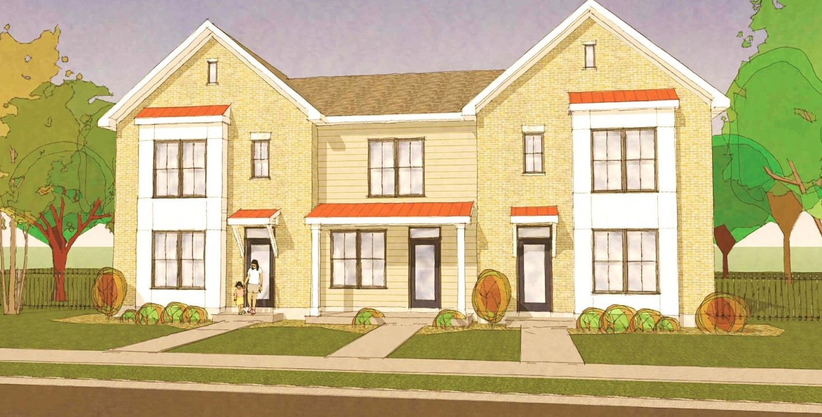

Housing
Pennrose

Slide 2
Housing Team
Housing Authority of the City of Tulsa
(Lead Applicant/Co-Developer)
HOUSING
Pennrose
(Housing Lead/Co-Developer)
George Kaiser Family Foundation
Anne & Henry Zarrow Foundation
Ascension St. John Foundation
Charles and Lynn Schusterman Family Philanthropies
Oklahoma Housing Finance Agency
The City of Tulsa and the Housing Authority of the City of Tulsa
M&T Realty Capital Corporation
RBC Capital Markets
Notes:
THA Jeff --> Intro
Pennrose Tim – Intro --> Discuss on past Pennrose CNI
Funders --> 30 seconds sans (City / MT / RBC)

Slide 3
Housing Team
Combat concentration of subsidized housing
Create high quality, well-managed mixed-income housing
Strengthen and diversify market demand
Place housing at the heart of the community

Slide 4
Housing Strategy Principles
One-for-one replacement
Compact, pedestrian-friendly, mixed-use
Community space/recreation
Defensible space
Enterprise Green Communities
Micro-climate appropriate landscaping
Sustainable stormwater management practices
Notes:
The housing plan is guided by CNI principals.

Slide 5
Conceptual Site Plan
A
A: Single Family Homes
B: Central Park
C: Community Center
and Management Building
D: Urban Farm
B
C
D
N
Notes:
WRT Woo Kim -->

Slide 6
Rendering

Slide 7
Current Mix by Development
 | 1 BR | 2 BR | 3 BR | 4 BR | 5 BR | Total | Total BRs
Comanche Park | 13 | 96 | 128 | 10 | 14 | 271 | 739
Total Existing | 13 | 96 | 128 | 10 | 14 | 271 | 739

Slide 8
One-for-One Replacement
Type | Existing | Project Based Vouchers | TOTAL | Existing Bedrooms | Replaced Bedrooms
1 BR | 13 | 33 | 33 | 13 | 33
2 BR | 96 | 98 | 98 | 192 | 196
3 BR | 128 | 128 | 128 | 384 | 384
4 BR | 20 | 10 | 10 | 80 | 40
5 BR | 14 | 2 | 2 | 70 | 10
TOTAL | 271 | 271 | 271 | 739 | 663

Slide 9
Proposed Unit Mix by Phase
Type | Market Rate | Tax Credit | PBV | Total
Phase I | 20 | 25 | 55 | 100
Phase II | 18 | 34 | 42 | 91
Phase III | 16 | 25 | 40 | 81
Phase IV | 17 | 15 | 40 | 72
Phase V | 19 | 33 | 44 | 96
Phase VI | 19 | 33 | 50 | 102
TOTAL | 109 | 165 | 271 | 545
Percent of Total | 20% | 30% | 50% | 100%
Type | Market Rate
Phase VII | 8
Notes:
The unit mix is distributed as equitably as is financially feasible across all phases
Less than 50% of units are subsidized replacement units
30 % Market
20% LIHTC Affordable
200 HAP units thru the existing BW HAP contract 200 PBV
Phase I – largest phase as is 4% LIHTC; largest number of Section 8 in any one phase;
Phase I - 51% replacement;. 29% Market 19% LIHTC
Phase II – 49% replacement 32% Market 18% LIHTC
Phase III – 48% replacement 30% Market 22% LIHTC
Phase IV –50% replacement 30% Market 19% LIHTC
Phase V – 49% replacement 30% Market 21& LIHTC

Slide 10
Proposed Unit Mix by Bedroom
Type | Market Rate | Tax Credit | PBV | Total
1 BR | 14 | 18 | 33 | 65
2 BR | 50 | 64 | 98 | 212
3 BR | 45 | 83 | 128 | 264
4 BR |  |  | 10 | 10
5 BR |  |  | 2 | 2
TOTAL | 109 | 165 | 271 | 553

Slide 11
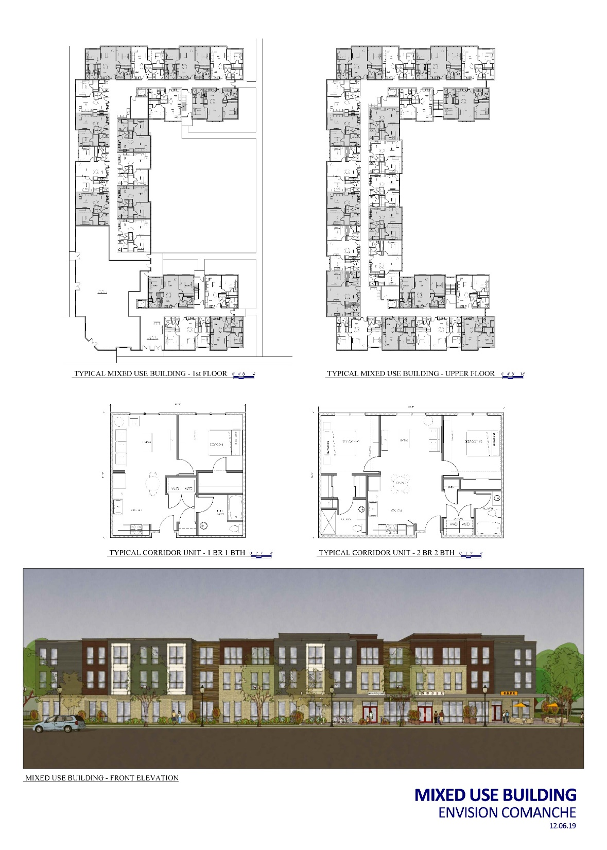
Sample Unit Plans – Mixed Use

Slide 12
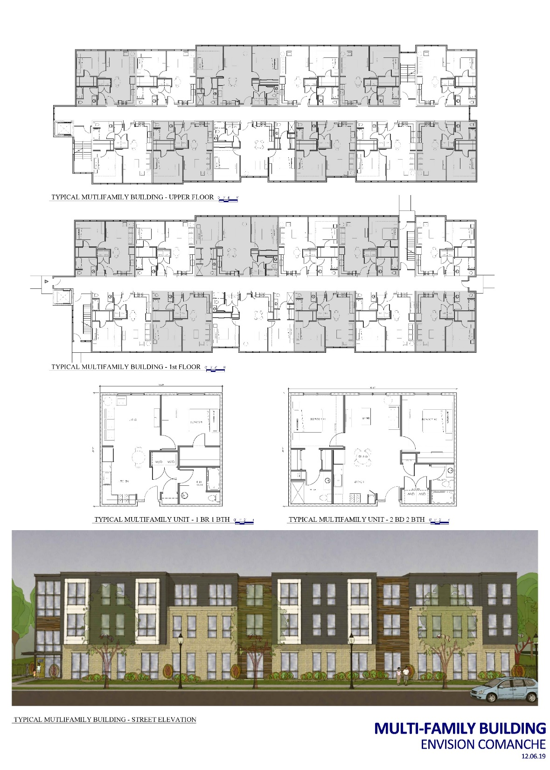
Sample Unit Plans – Multi-Family

Slide 13
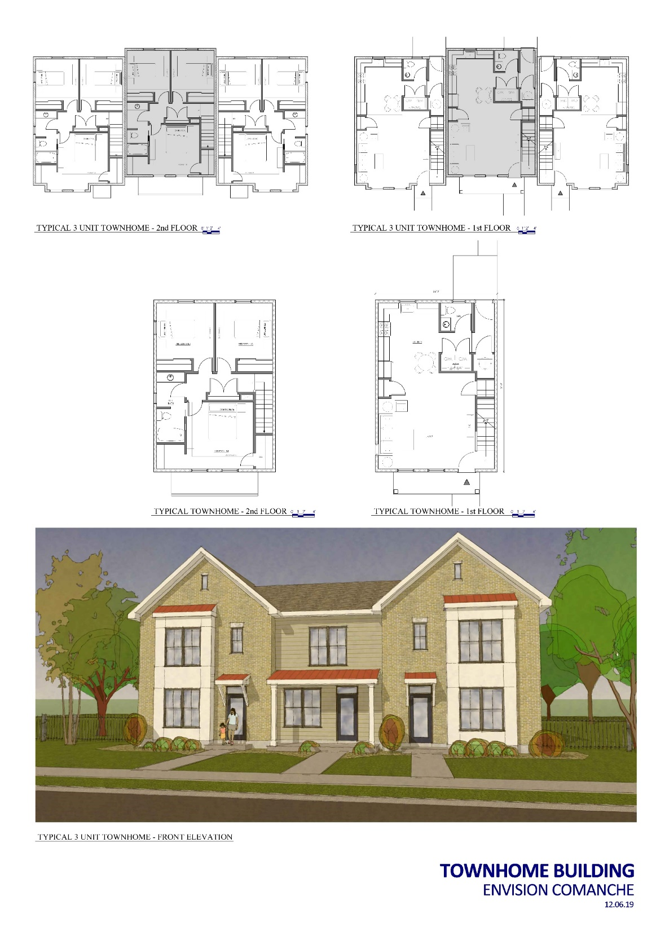
Sample Unit Plans – Townhomes

Slide 14
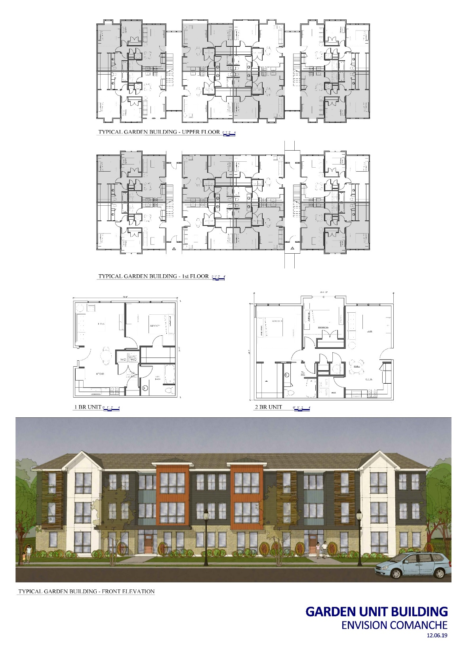
Sample Unit Plans – Gardens

Slide 15
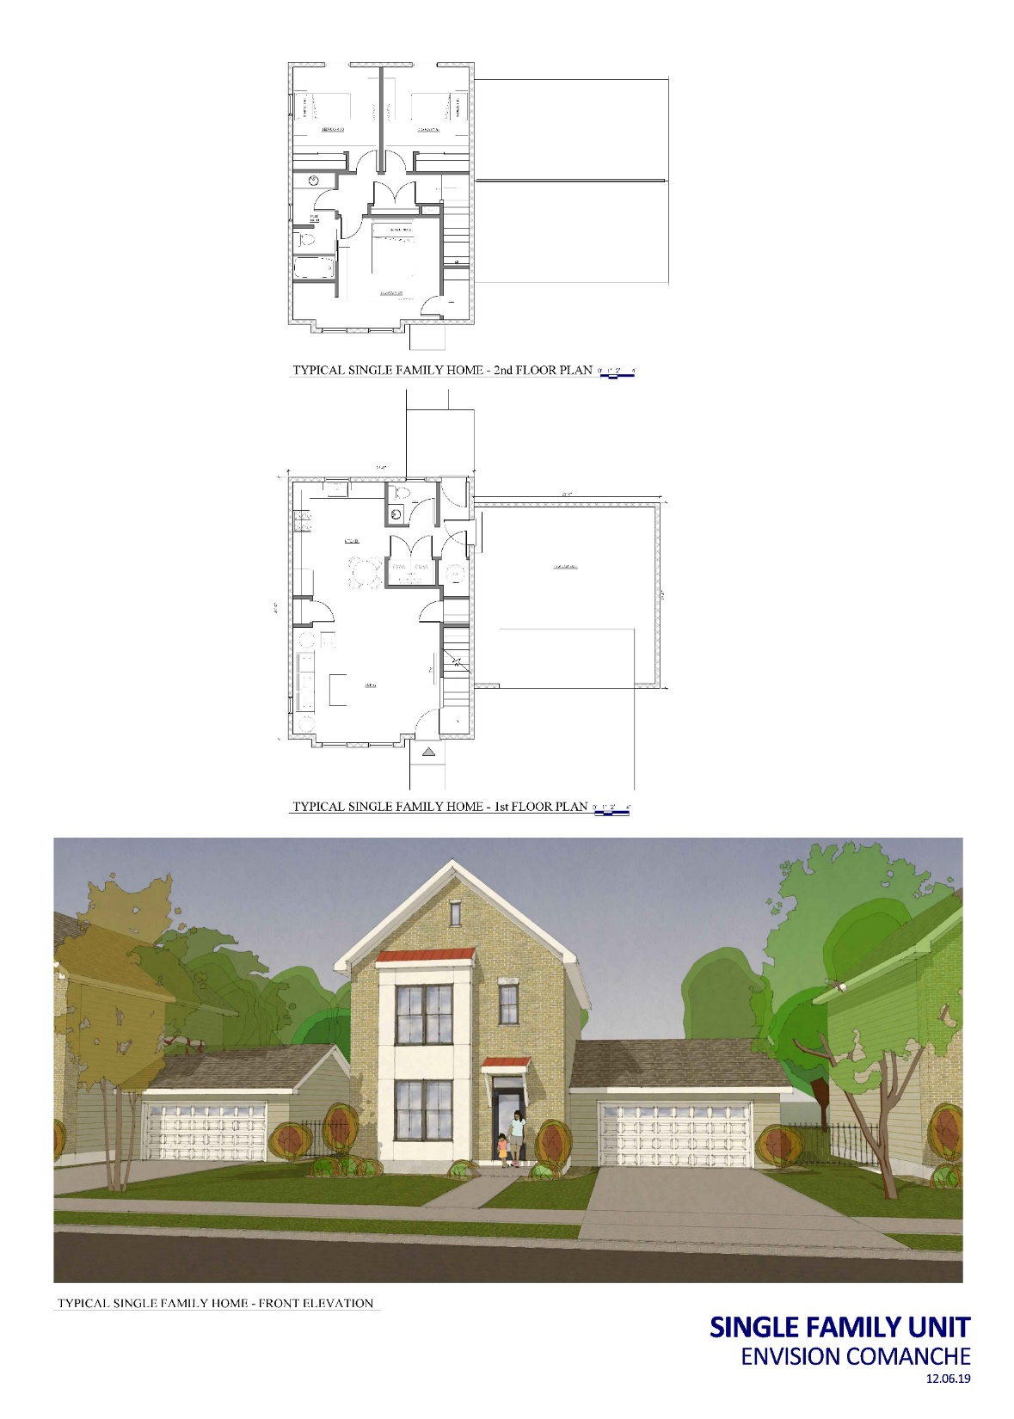
Sample Unit Plans – Single Family Homes

Slide 16
Housing Schedule
Activity | 2022 | 2023 | 2024 | 2025 | 2026 | 2027 | 2028
Grant Milestones
Demolition
Relocation
Public Improvements
Phase I
Phase II
Phase III
Phase IV
Phase V
Phase VI
Phase VII
Case Mgmt & Supportive Services
Award
Y1 Funding
Y2 Funding
Y3 Funding
Y4 Funding
Y5 Funding
Demo Phase I
Demo Phase II
Demo Phase III
TPV Q4
Relocation
PI for Phase I and II
PI for Phase III and IV
PI for Phase V, VI, VII
Phase I Pre-dev
Phase I LIHTC
Phase I NTP + Construction
Phase I PIS
Complete Stabilization
Phase II Pre-dev
Phase II LIHTC
Phase II NTP + Construction
Phase II PIS
Complete Stabilization
Phase III Pre-dev
Phase III LIHTC
Phase III NTP + Construction
Phase III PIS
Complete Stabilization
Phase IV Pre-dev
Phase IV LIHTC
Phase IV NTP + Construction
Phase IV PIS
Complete Stabilization
Phase V Pre-dev
Phase V LIHTC
Phase V NTP + Construction
Phase V PIS
Complete Stabilization
Phase VI Pre-dev
Phase VI LIHTC
Phase VI NTP + Construction
Phase VI PIS
Complete Stabilization
Phase VII NTP + Construction
Case Management & Supportive Services
Notes:
THA Jeff

Slide 17
All Phases Sources & Uses
USES Part A
Acquisition | $0
Construction | $121,242,619
Pre-Development | $8,066,689
Legal | $1,619,310
Financing | $6,778,399
Escrow | $2,274,178
Developer Fee | $16,644,143
TOTAL USES Part A | $156,625,338
SOURCES Part A
CNI | $28,722,251
Foundation Sources | $14,218,588
First Mortgage | $49,429,400
Tax Credit Equity | $53,946,600
THA Program Income | $530,000
Deferred Developer Fee | $9,778,499
TOTAL SOURCES Part A | $156,625,338
USES Part B
CNI – Administration | $2,500,000
CNI – People / CCI | $15,000,000
CNI – Relocation | $800,000
Public Improvements | $20,909,191
Demolition and Asbestos | $5,200,000
Foundation – People / Neighborhood | $8,836,638
TOTAL USES Part B | $53,995,829
SOURCES Part B
CNI | $21,277,749
Foundation Sources | $14,281,412
THA Capital Funds / Program Income | $4,736,668
City of Tulsa | $12,200,000
City of Tulsa CDBG | $1,500,000
TOTAL SOURCES Part B | $53,995,829
TOTAL DEVELOPMENT COST | $210,621,167
Notes:
Pennrose Tom

Slide 18
Relocation and Returns
Tenant Protection Vouchers
  Requested 271 TPVs
Relocation Program
  Priority return rights for all current Comanche Park Residents
  Pre-relocation counseling to ensure residents are moving to areas of opportunity (good schools, jobs, etc.)
  Offers services prior to relocation and during the transformation
  Helps residents address barriers that might hinder their return
Notes:
THA Jeff

Slide 19
Relocation, Demolition, Phasing
Comanche Park families relocated off-site
(2023-2024)
Comanche Park demolition (2022-2024)
Residents relocate/return to completed Phases I, II, III (2024-2025)
Residents return to completed Phases IV, V, VI (2026-2027)
Single Family Development Complete Phase VII (2028)
Phase I - 100 Units
Phase II - 94 Units
Phase III - 81 Units
Phase IV - 72 Units
Phase V - 96 Units
Phase VI - 102 Units
Phase VII - 8 Units
Notes:
THA Jeff

Slide 20
Project Readiness
Clean Phase I ESA
Full site control
  Comanche Park
  Phase I
Section 18 demolition application submitted and under SAC review
Part 58 clearance
9% set aside in the QAP
Confirmed soft sources
Notes:
THA Jeff

Slide 21
Questions?

Slide 22
Housing
Appendix

Slide 23
Unit Mix by Phase – Phase I
Type | Market Rate | Tax Credit | PBV* | Total
1 BR | 5 | 18 | 28 | 51
2 BR | 15 | 7 | 27 | 49
3 BR
4 BR
5 BR
TOTAL | 20 | 25 | 55 | 100

Slide 24
Unit Mix by Phase – Phase II
Type | Market Rate | Tax Credit | PBV* | Total
1 BR | 9 |  | 5 | 14
2 BR | 5 | 14 | 22 | 41
3 BR | 4 | 20 | 15 | 39
4 BR
5 BR
TOTAL | 18 | 34 | 42 | 94

Slide 25
Unit Mix by Phase – Phase III
Type | Market Rate | Tax Credit | PBV* | Total
1 BR
2 BR | 14 | 20 | 26 | 60
3 BR | 2 | 5 | 14 | 21
4 BR
5 BR
TOTAL | 16 | 25 | 40 | 81

Slide 26
Unit Mix by Phase – Phase IV
Type | Market Rate | Tax Credit | PBV* | Total
1 BR
2 BR | 2 | 2 | 2 | 6
3 BR | 15 | 13 | 33 | 61
4 BR |  |  | 5 | 5
5 BR
TOTAL | 17 | 15 | 40 | 72

Slide 27
Unit Mix by Phase – Phase V
Type | Market Rate | Tax Credit | PBV* | Total
1 BR
2 BR | 3 | 4 | 7 | 14
3 BR | 16 | 29 | 33 | 78
4 BR |  |  | 3 | 3
5 BR |  |  | 1 | 1
TOTAL | 19 | 33 | 44 | 96

Slide 28
Unit Mix by Phase – Phase VI
Type | Market Rate | Tax Credit | PBV* | Total
1 BR
2 BR | 11 | 17 | 14 | 42
3 BR | 8 | 16 | 33 | 57
4 BR |  |  | 2 | 2
5 BR |  |  | 1 | 1
TOTAL | 19 | 33 | 50 | 102

Slide 29
Unit Mix by Phase – Phase VII
Type | Market Rate | Tax Credit | PBV* | Total
1 BR
2 BR
3 BR | 8 |  |  | 8
4 BR
5 BR
TOTAL | 8 |  |  | 8

Slide 30
Phase I – Sources and Uses
USES Part A
Construction | $20,352,908
Pre-Development | $1,336,335
Legal | $325,000
Financing | $858,784
Escrow | $388,764
Developer Fee | $2,791,415
TOTAL USES Part A | $26,053,206
SOURCES Part A
CNI | $6,000,000
Foundation Sources | $4,890,656
First Mortgage | $5,055,100
Tax Credit Equity | $8,991,100
THA Program Income
Deferred Developer Fee | $1,116,350
TOTAL SOURCES Part A | $26,053,206
USES Part B
CNI – Administration | $416,666
CNI – People / CCI | $2,500,000
CNI – Relocation | $300,000
Public Improvements | $5,168,479
Demolition and Asbestos | $866,665
Foundation – People / Neighborhood | $1,419,202
TOTAL USES Part B | $10,671,012
SOURCES Part B
CNI | $3,712,957
Foundation Sources | $1,544,627
THA Capital Funds / Program Income | $370,374
City of Tulsa | $5,043,054
City of Tulsa CDBG
TOTAL SOURCES Part B | $10,671,012

Slide 31
Phase II – Sources and Uses
USES Part A
Construction | $20,962,017
Pre-Development | $1,489,734
Legal | $257,050
Financing | $1,045,410
Escrow | $375,696
Developer Fee | $2,895,589
TOTAL USES Part A | $27,025,496
SOURCES Part A
CNI | $4,000,000
Foundation Sources | $5,162,056
First Mortgage | $7,365,600
Tax Credit Equity | $8,991,100
THA Program Income
Deferred Developer Fee | $1,506,740
TOTAL SOURCES Part A | $27,025,496
USES Part B
CNI – Administration | $416,666
CNI – People / CCI | $2,500,000
CNI – Relocation | $300,000
Public Improvements | $3,660,575
Demolition and Asbestos | $866,665
Foundation – People / Neighborhood | $1,419,202
TOTAL USES Part B | $9,163,108
SOURCES Part B
CNI | $3,712,957
Foundation Sources | $1,419,202
THA Capital Funds / Program Income | $768,165
City of Tulsa | $3,262,784
City of Tulsa CDBG
TOTAL SOURCES Part B | $9,163,108

Slide 32
Phase III – Sources and Uses
USES Part A
Construction | $17,826,013
Pre-Development | $1,169,172
Legal | $229,832
Financing | $937,949
Escrow | $332,843
Developer Fee | $2,459,497
TOTAL USES Part A | $22,955,306
SOURCES Part A
CNI | $4,750,000
Foundation Sources | $1,408,824
First Mortgage | $6,494,700
Tax Credit Equity | $8,991,100
THA Program Income
Deferred Developer Fee | $1,310,682
TOTAL SOURCES Part A | $22,955,306
USES Part B
CNI – Administration | $416,666
CNI – People / CCI | $2,500,000
CNI – Relocation | $300,000
Public Improvements | $4,839,021
Demolition and Asbestos | $866,665
Foundation – People / Neighborhood | $1,419,202
TOTAL USES Part B | $10,091,554
SOURCES Part B
CNI | $3,462,957
Foundation Sources | $1,419,202
THA Capital Funds / Program Income | $666,133
City of Tulsa | $3,894,162
City of Tulsa CDBG | $649,100
TOTAL SOURCES Part B | $10,091,554

Slide 33
Phase IV – Sources and Uses
USES Part A
Construction | $15,871,864
Pre-Development | $1,061,119
Legal | $211,691
Financing | $1,112,992
Escrow | $304,196
Developer Fee | $2,227,423
TOTAL USES Part A | $20,789,285
SOURCES Part A
CNI | $1,500,000
Foundation Sources
First Mortgage | $8,816,200
Tax Credit Equity | $8,991,100
THA Program Income
Deferred Developer Fee | $1,481,985
TOTAL SOURCES Part A | $20,789,285
USES Part B
CNI – Administration | $416,666
CNI – People / CCI | $2,500,000
CNI – Relocation | $50,000
Public Improvements | $2,627,835
Demolition and Asbestos | $866,669
Foundation – People / Neighborhood | $1,419,202
TOTAL USES Part B | $7,880,372
SOURCES Part B
CNI | $3,462,957
Foundation Sources | $3,058,983
THA Capital Funds / Program Income | $670,378
City of Tulsa
City of Tulsa CDBG | $688,054
TOTAL SOURCES Part B | $7,880,372

Slide 34
Phase V – Sources and Uses
USES Part A
Construction | $21,328,646
Pre-Development | $1,396,281
Legal | $285,122
Financing | $1,393,629
Escrow | $417,043
Developer Fee | $2,978,486
TOTAL USES Part A | $27,799,207
SOURCES Part A
CNI | $4,500,000
Foundation Sources | $1,173,719
First Mortgage | $11,056,600
Tax Credit Equity | $8,991,100
THA Program Income
Deferred Developer Fee | $2,077,788
TOTAL SOURCES Part A | $27,799,207
USES Part B
CNI – Administration | $416,666
CNI – People / CCI | $2,500,000
CNI – Relocation | $50,000
Public Improvements | $3,800,558
Demolition and Asbestos | $866,665
Foundation – People / Neighborhood | $1,419,202
TOTAL USES Part B | $9,053,091
SOURCES Part B
CNI | $3,462,957
Foundation Sources | $4,348,770
THA Capital Funds / Program Income | $1,078,518
City of Tulsa
City of Tulsa CDBG | $162,846
TOTAL SOURCES Part B | $9,053,091

Slide 35
Phase VI – Sources and Uses
USES Part A
Construction | $23,741,171
Pre-Development | $1,534,048
Legal | $310,615
Financing | $1,389,635
Escrow | $455,636
Developer Fee | $3,291,733
TOTAL USES Part A | $30,722,838
SOURCES Part A
CNI | $7,972,251
Foundation Sources | $833,333
First Mortgage | $10,641,200
Tax Credit Equity | $8,991,100
THA Program Income
Deferred Developer Fee | $2,284,954
TOTAL SOURCES Part A | $30,722,838
USES Part B
CNI – Administration | $416,670
CNI – People / CCI | $2,500,000
CNI – Relocation | $50,000
Public Improvements | $812,723
Demolition and Asbestos | $866,671
Foundation – People / Neighborhood | $1,419,202
TOTAL USES Part B | $6,065,266
SOURCES Part B
CNI | $3,462,964
Foundation Sources | $1,419,202
THA Capital Funds / Program Income | $1,183,100
City of Tulsa
City of Tulsa CDBG
TOTAL SOURCES Part B | $6,065,266

Slide 36
Phase VII – Sources and Uses
USES Part A
Construction | $1,160,000
Pre-Development | $80,000
Legal
Financing | $40,000
Escrow
Developer Fee
TOTAL USES Part A | $1,280,000
SOURCES Part A
CNI
Foundation Sources | $750,000
First Mortgage
Tax Credit Equity
THA Program Income | $530,000
Deferred Developer Fee
TOTAL SOURCES Part A | $1,280,000
USES Part B
CNI – Administration
CNI – People / CCI
CNI – Relocation
Public Improvements
Demolition and Asbestos
Foundation – People / Neighborhood | $1,071,426
TOTAL USES Part B | $1,071,426
SOURCES Part B
CNI
Foundation Sources | $1,071,426
THA Capital Funds / Program Income
City of Tulsa
City of Tulsa CDBG
TOTAL SOURCES Part B | $1,071,426

