Slide 1
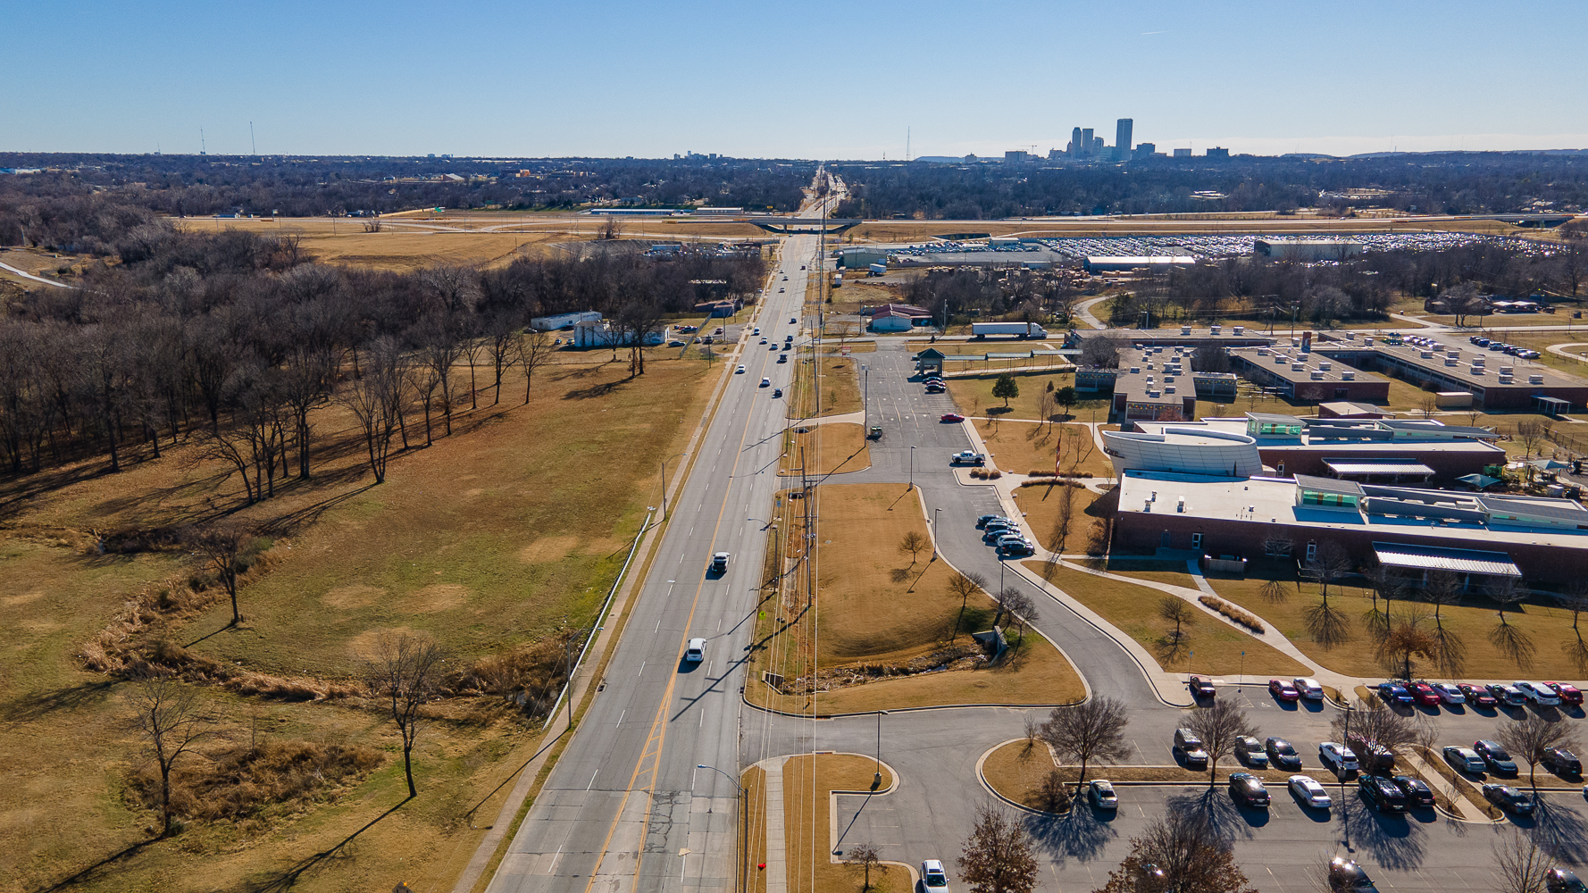

Neighborhood
City of Tulsa

Slide 2
Neighborhood Team
Residents & Stakeholders
CCI Leads
Neighborhood Implementation Entity
Partner Tulsa
(Lead Community and Economic Development Agency for COT)
(Convener & Facilitator)
Other Neighborhood Investments
The City of Tulsa
(Co-Applicant)
Notes:
Welcome everyone, my name as Kian Kamas, and I have the pleasure of serving as Executive Director of PartnerTulsa – or, more formally, the Tulsa Authority for Economic Opportunity. PartnerTulsa serves as the lead agency executing the City of Tulsa's economic and community development strategy, and was formed out of the effective merger of five (5) formerly separate public entities. We are focused on increasing economic opportunity for Tulsa residents and eliminating racial disparities through a collective approach that recognizes the multiple interventions cities must execute to lift up the lives of our most vulnerable residents.
Our model is unique from many cities you may work with, and provides Tulsa with substantial resources that were previously siloed and inaccessible. We own and manage over 180+ assets, including major parking assets downtown, industrial assets that are home to Tulsa’s largest employers, and residential and commercial parcels which we leverage disposition of in support of our neighborhood redevelopment goals.
In the context of this grant application, we stand as the lead implementer of many of the city’s most comprehensive neighborhood redevelopment goals, managing major tools and programs such as Tax Increment Finance districts and commercial revitalization incentives, and we see ourselves as a fundamental partners to THA and its funders and partners.

Slide 3
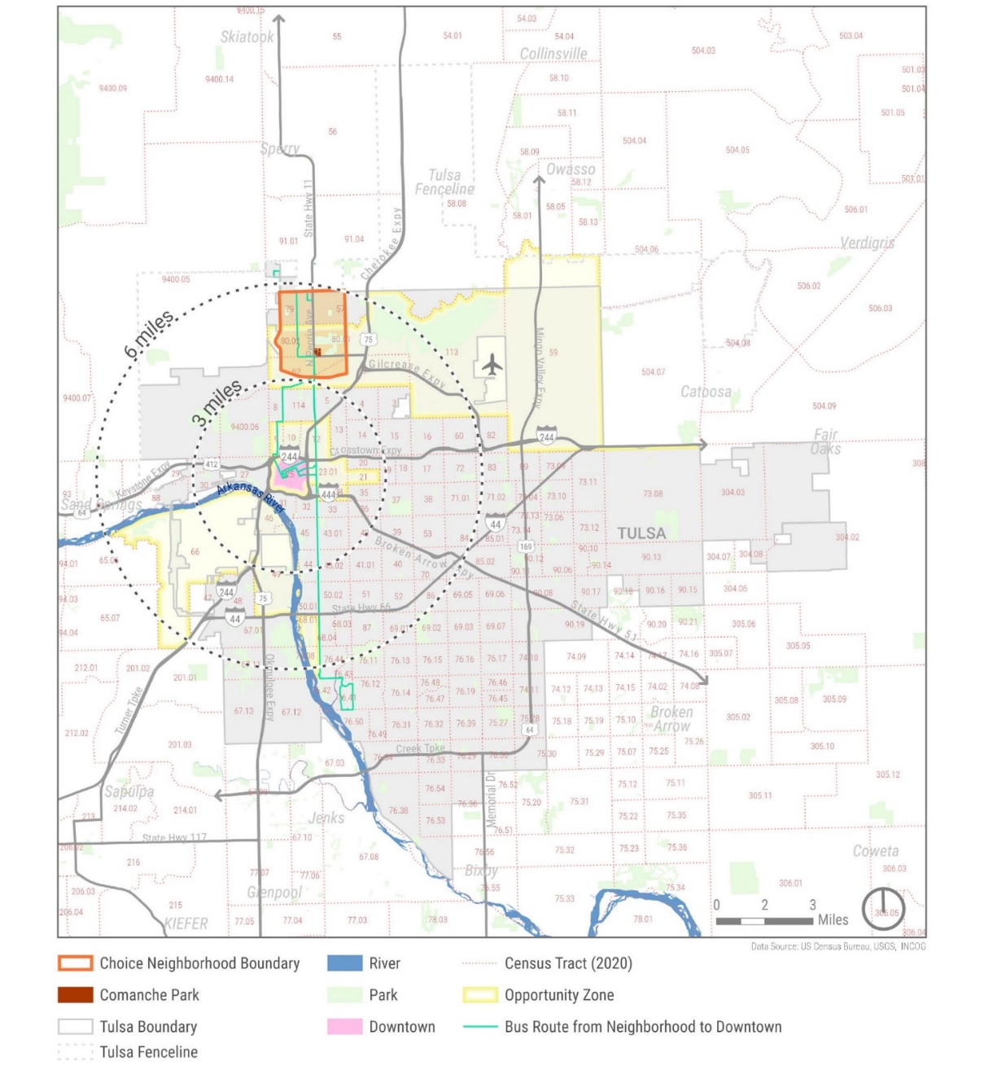
Context
Notes:
To provide context, the intersection of 36th Street North and Peoria is one which has been a focal point for the City of Tulsa for nearly a decade. From a geographic standpoint, the neighborhood occupies a unique position, located equidistant from the city’s Central Business District in Downtown Tulsa, and our airport industrial corridor – both of which are undoubtedly our two largest jobs centers, providing access to quality employment opportunities in a variety of industry sectors.
In addition to this strategic geographic location, the Peoria corridor has been a focal point for the City of Tulsa and was the natural choice for implementation of the first phase of our Bus Rapid Transit system, which stretches from two miles to the north of the corner down to 81st Street South.

Slide 4
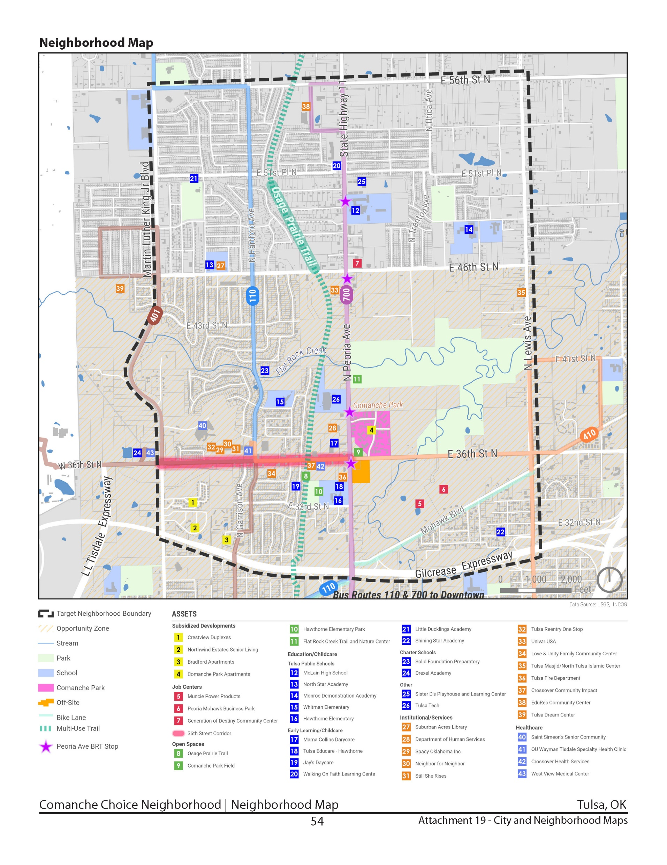
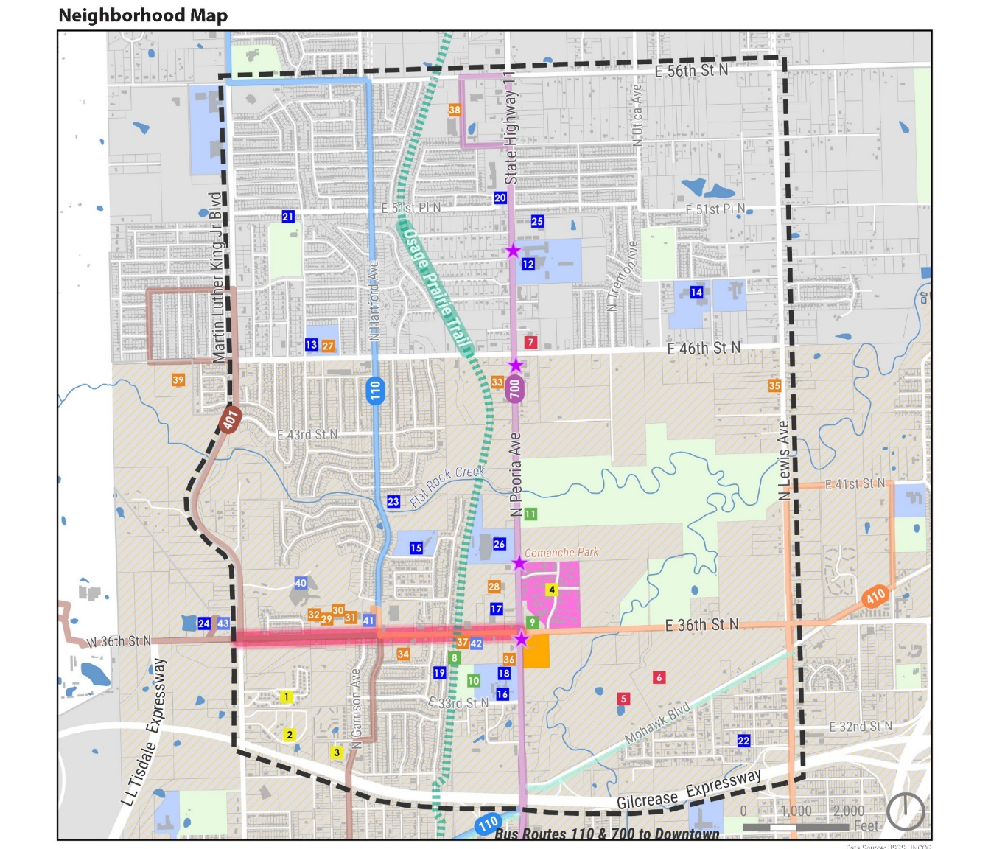
Neighborhood Map
Notes:
In assessing where we should focus investments, we undoubtedly look to the assets within a neighborhood that will prove critical to long-term success. As you can see from this asset map, the area surrounding Comanche Park is rich with a variety of assets that are all instrumental to broad economic success.
From a strengths standpoint, investments in schools, increasing access to quality job opportunities, and proximity to medical facilities, as well as the centralized nature of many assets will prove valuable in our efforts to reinvigorate this neighborhood.

Slide 5
Neighborhood Challenges
Concentrated density of subsidized housing in isolated superblocks
  271 total HUD subsidized housing units
  Lack of connectivity
Notes:
Conversely, we recognize that there are major assets within the area that stand as distinct barriers to our efforts to increase economic opportunity within the area. Undoubtedly, one of the greatest challenges within the area is the Comanche Park complex itself. The structure of the complex has led to a density of isolated, subsidized housing that lacks connectivity to the broader community. This, in turn, creates safety concerns within the complex itself and presents a broader challenge to how the complex creates both real and perceived barriers to development.
**If appropriate, provide context on discussions we have had with prospective employers about the potential for crime and the impact of the density of poverty on the business park long-term.

Slide 6
Response: Mixed-Income Housing Plan
Notes:
Our response to this challenge is the development of a deliberate mixed-income housing plan that seeks to diversify the level of income within the neighborhood and reintroduce a more connected neighborhood feel and structure into the built environment.
**Kian to ask Jeff for additional comments or details on the housing plan for Comanche Park.

Slide 7
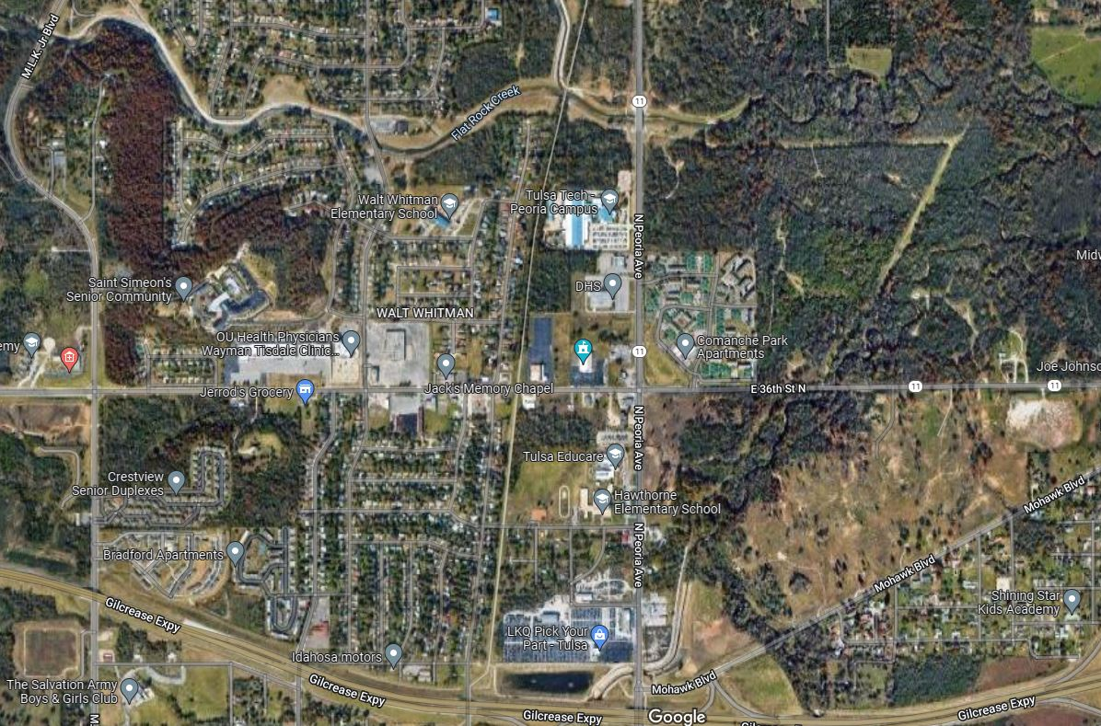
Neighborhood Challenges
Aging housing stock
Vacant and underutilized land
Notes:
Another substantial challenge within the plan area is aging housing stock and vacant and underutilized land. On the latter, I’ll note that much of the vacant land to the north is within the floodplain, which limits development potential in some respects, but presents opportunities for more recreational-based uses.
For this challenge, one of the most impactful aspects of Tulsa’s application for this grant is the fact that we come into this initiative with a suite of powerful tools that we have developed to directly address these challenges. This is done through a two-pronged approach:
Proactively working with private developers to support their efforts to invest in the neighborhood, and
Developing critical tools and funding resources that will provide the City with the resources it needs to step up our housing initiatives in the area.

Slide 8



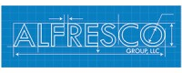
Response: Private Development Partnerships
$61.6 million in investments
- Single-family home development
- Construction of 70,000 sqft community center and athletic field
- Construction of live work development on 9 acres
- Expansion of health services clinic
$15 million in investments
- Development of 60 residential lots
- Construction of single-family homes
$11 million in investments
- Development of 250 housing units
- Various infill lots for single-family homes
$75 million in investments
- Construction of 270 unit mixed-use, multi-family development
- 45,000 sqft of retail
- 109 room boutique hotel
Notes:
On the former, we have the benefit of working with four (4) major private projects that will become key assets supporting the broader growth of this neighborhood:
At the opposite end of the 36th Street North corridor, local development group, Alfresco Group, LLC, will break ground in 2022 on a new mixed-use development that will incorporate a boutique hotel, named after and inspired by J.B. Stratford whose Tulsa hotel was the largest Black-owned hotel in the country before its destruction in the 1921 Tulsa Race Massacre. Our team helped to facilitate this development through a TIF district established for the corridor. The target neighborhood and housing site are also located within a designated Opportunity Zone.
In addition to this, both Capital Homes (a local home builder who has substantial experience executing quality, neighborhood-scale projects throughout Tulsa) and Habitat for Humanity have committed to investing in major new projects in the immediate area. On the latter, we worked with Habitat and the Tulsa Metropolitan Utility Authority to secure funding for critical wastewater infrastructure which was needed for the project to move forward.
Finally Crossover Community Impact is working to develop a large-scale site that includes community centers, learning centers, residential, and mixed use development.

Slide 9
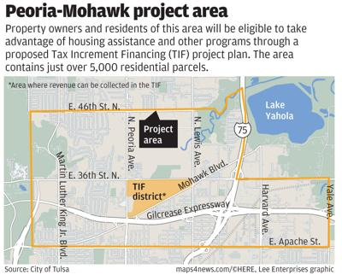
Response: Peoria-Mohawk TIF
$41 million in housing support through TIF
  $35 million: Housing rehabilitation, new housing development, title clearing, and selective demolition
  $1.8 million: Flat Rock Creek Urban Wilderness Project
  $4.2 million: Support to Tulsa Public Schools in plan area
Notes:
In addition to supporting known private developments in the neighborhood, we have been focused on developing powerful tools which we know will be key to spurring further development in the area.
As has been noted previously, one of the greatest assets in the area is the establishment of the Peoria Mohawk Business Park. This business park provides the opportunity for $10s – if not $100s – of millions of dollars in investment in the neighborhood. Traditionally, our approach with investments of this nature has been to leverage a TIF to support these investments themselves. But – given the presence of a broader city incentive through the Vision Tulsa program – we have been able to structure a unique TIF within this area that captures the increment generated within the business park and dedicates that increment to housing programs in the four (4) census tracts surrounding the park.
This TIF was deliberately structured in recognition that in order for our plans to succeed long-term, we needed to invest in the people living in the neighborhood, and we needed to create the tools that would help us tackle and address the problems we saw within those neighborhoods – including aging, vacant, and blighted housing.

Slide 10
Neighborhood Challenges
Limited healthy food options
Notes:
**Jeff to handle and explain the challenge and response

Slide 11
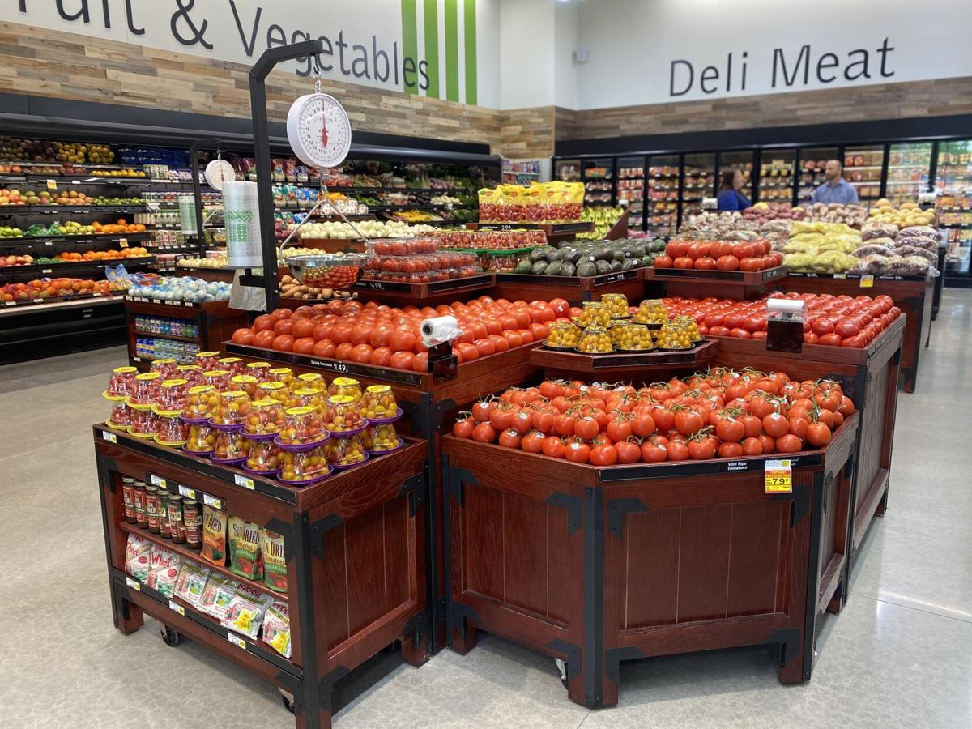
Response: Neighborhood-Scale Grocery Store
Sources of Funding:
CNI $750,000
George Kaiser Family Foundation $250,000
Total $1,000,000
Partners:
Greencore Network
R&G Family Grocers
Community Food Bank of Eastern Oklahoma
George Kaiser Family Foundation
Grocery Operator

Slide 12
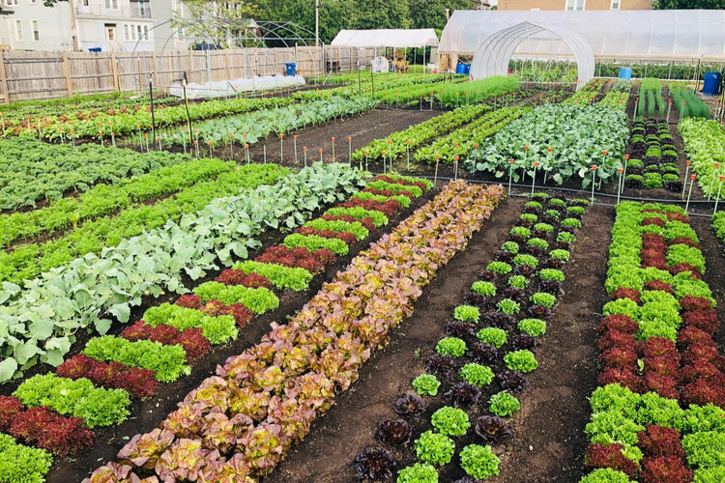
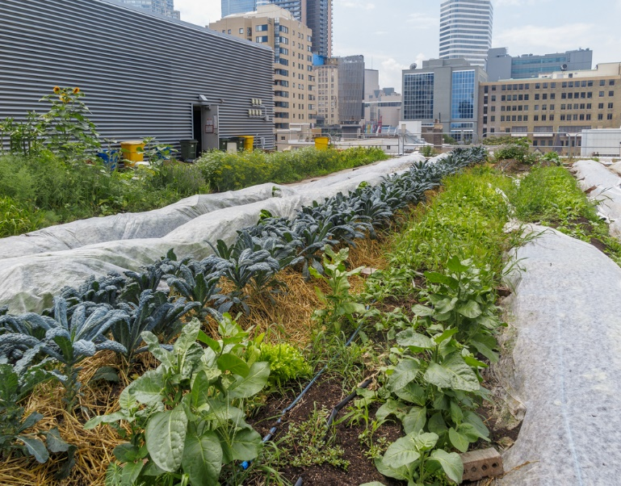
Response: Urban Farm
Sources of Funding:
CNI $500,000
George Kaiser Family Foundation $250,000
Total $750,000
Partners:
Greencore Network
R&G Family Grocers
Community Food Bank of Eastern Oklahoma
George Kaiser Family Foundation
Grocery Operator

Slide 13
Neighborhood Challenges
Disinvestment and lack of retail and commercial establishments
Notes:
Kian: Unsurprisingly, the disinvestment experienced over the past decades in this neighborhoods – which led to a decrease in population, and a concentration of poverty for those who remained – had the corresponding effect of limiting retail and commercial establishments and critical goods and services.

Slide 14
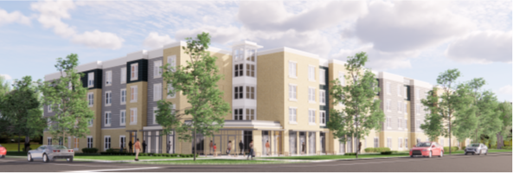
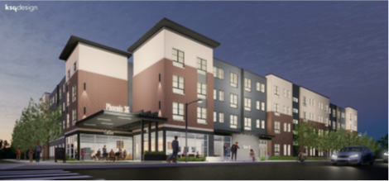
Response: Mixed-Use Development
Capitalize on Peoria & 36th Opportunity to bring commercial activity
Strengthen commercial core through mixed-use development
Build upon major public investments along 36th Street including Crossover Community Impact development
Notes:
As a result the development plan proposes to bring in mixed used development and offer first floor retail to incorporate grocery stores, corner marts, small commercial spaces, etc.
Kian to ask Jeff if he has anything to add.

Slide 15
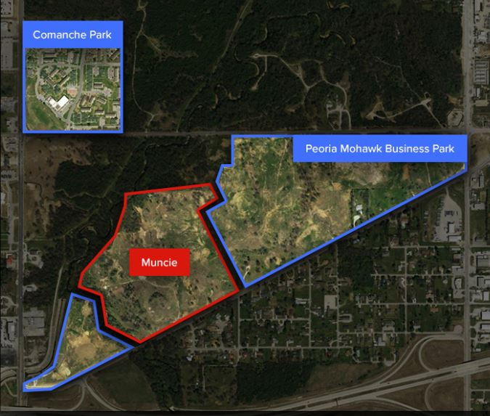
Response: Driving Demand and Generators
Peoria Mohawk Business Park
Establish a center for high-quality jobs accessible to neighborhood residents
Attract employers with a proven record of "skilling up" and investing in employees
Muncie Power Products – 300,000 sqft
Phase I ribbon cutting July 2022; Phase II in 2023 with Phase III in 2024-2025
Salaries average $45,000 for floor staff and $80,000 for managers; expected to hire 250 people
Partnering with George Kaiser Family Foundation to plan for "spec" industrial buildings to capitalize on increased interest from companies with short development timelines
Notes:
To return to our theme of developing multi-pronged strategies to build a solid economic foundation within this neighborhood, a key aspect of this plan long-term involves the creation of quality employment opportunities within the neighborhood. The Peoria Mohawk Business Park ultimately serves to key roles within the neighborhood:
First, the park introduces a base of employment and workers that provides for an increase in daytime population that will provide enhanced demand within the neighborhood, thereby increasing the potential for the city and our partners to attract new retailers and service providers.
Secondly, our focus on attracting employers that are committed to hiring from within the neighborhood is meant to ensure that the economic activity generated by the neighborhood is experienced more broadly, and becomes a stimulus that impacts the commercial corridors more fully.
As you can see form the stats listed on this slide, our initial employer – Muncie Power Products – brings substantial investment and job opportunities to the neighborhood. We are currently working with Muncie on targeted strategies to ensure neighborhood residents have access to employment opportunities now and as Muncie grows.

Slide 16

Response: Small Business Recruitment &
Incentive Fund
Sources of Funding:
CNI $2,500,000
George Kaiser Family Foundation $1,500,000
City Commercial Revitalization Fund $375,000
Total $4,375,000
Partners:
Vibrant Neighborhoods Partnership
Phoenix Development Council
North Tulsa Economic Development Initiative
Partner Tulsa
City of Tulsa
Tulsa Economic Development Corporation
EduRec Tulsa
Notes:
Established as a revolving loan fund, this proposed CCI project will expand on the incentive programs offered through the Peoria BRT and the TIF Districts. This fund will enable the expansion of the available boundaries to include the entire Phoenix District and further leverage the funds provided by the TIF funding. Planned investments provided through this fund include façade improvements for local businesses, assistance with acquisitions and tenant buildout costs, and business expansion

Slide 17

Response: Community Hub for Small Business Training
Sources of Funding:
CNI $1,250,000
Charles & Lynn Schusterman Family Philanthropies $250,000
Owner Equity $3,500,000
Total $5,000,000
Partners:
Vibrant Neighborhoods Partnership
Phoenix Development Council
North Tulsa Economic Development Initiative
Partner Tulsa
City of Tulsa
Tulsa Economic Development Corporation
EduRec Tulsa
Notes:
Built in conjunction with the planned expansion of EduRec Tulsa, a local 501(c)(3) organization operating out of 53,000 square foot facility located on 15 acres of land at the southeast corner of North Peoria Avenue and 56th Street North, the HUB will serve as the starting point for new and emerging small businesses in the neighborhood. This proposed CCI project will provide intentional training and classroom spaces, and open area for technical and trade specific trainings. New and emerging businesses will be provided the coaching and technical assistance needed to establish and grow their businesses and provided access to a Business Center to support the technology needs of their business, better ensuring target neighborhood-based businesses can take advantage of current and planned commercial incentives.

Slide 18
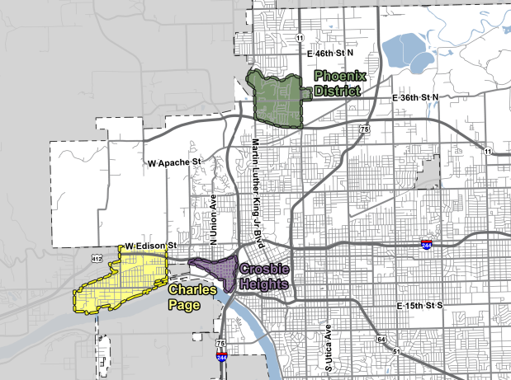

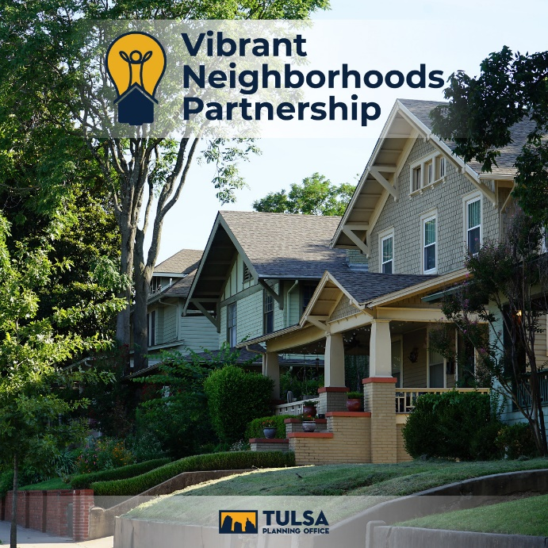
Response: Vibrant Neighborhoods Partnership
Notes:
Mayor
Even with all the planned investments and projects outlined, the City recognizes the need for continued planning and monitoring of progress as the Comanche Park area transforms.
Which is why the City, through the Tulsa Planning Office, selected this area as one of the very first neighborhoods to participate in the City's Vibrant Neighborhoods Partnership (VNP) program.
VNP is a community-driven collaboration to improve residents' quality-of-life by developing neighborhood infrastructure and focusing public supports and service delivery. Guided by dedicated Tulsa Planning Office staff, the goal of the VNP is to bring City departments, community partners, and neighborhood residents together to identify and address challenges and opportunities through clearly defined and time-bound actions.
Tools and resources to support the Phoenix District include:
• Pedestrian and bicycle infrastructure
• Public art, wayfinding, and beautification
• Food access initiatives
• Housing and homeowner support
• After school and youth programming
• Public safety support
CLOSING REMARKS

Slide 19
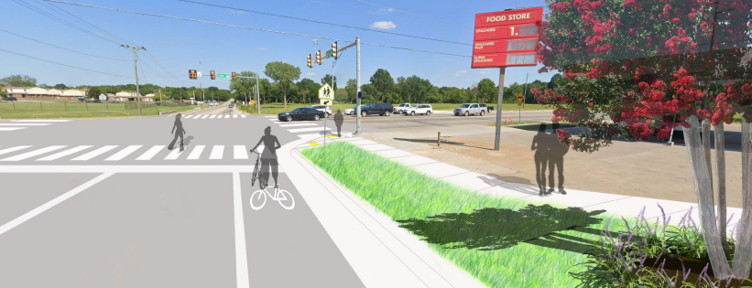
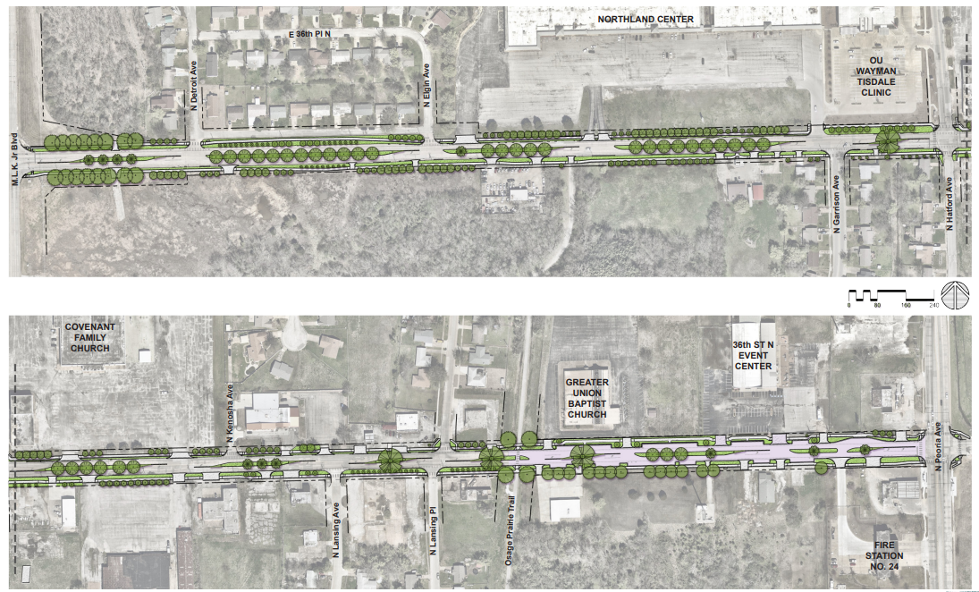
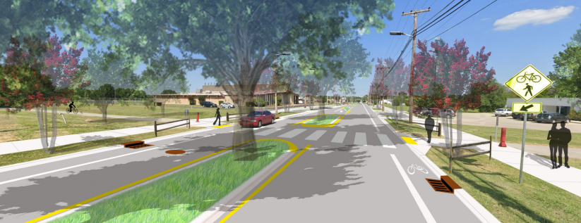
Response: Public Infrastructure Investments
Notes:
Mayor
These private activities are complimented by on-going major infrastructure improvements that will connect these major hubs of transformation to create a vibrant corridor.
Moving East to West
36th Street North project: This $5,000,000 project includes waterline replacement, patching or reconstruction under the road surface, and then repaving with a new asphalt overlay. The street will be reconfigured to one lane in each direction with occasional center turn lanes, new landscaped medians, bike lanes that connect with the Osage Prairie Trail, new sidewalks, lighting, crosswalk markings, and more than 300 new trees. On-street parallel parking will be included between the Osage Prairie Trail and Peoria Avenue. When completed, the street will encourage new pedestrian‑oriented businesses, walking, and biking, and will discourage speeding.
Moving North to South
Peoria Connection project ($7,000,000). Acquire and prepare land, including streetscaping and infrastructure improvements, for future economic development, along North Peoria Avenue from 56th Street North to Mohawk Boulevard.
$2,590,000 - Hawthorne Neighborhood Street Rehabilitation , new landscaping along the street edge
$2,370,000 - Hawthorne and Walt Whitman Neighborhood Street Rehabilitation

Slide 20
Neighborhood Challenges
Lack of amenities
Notes:
**Jeff to handle this slide

Slide 21
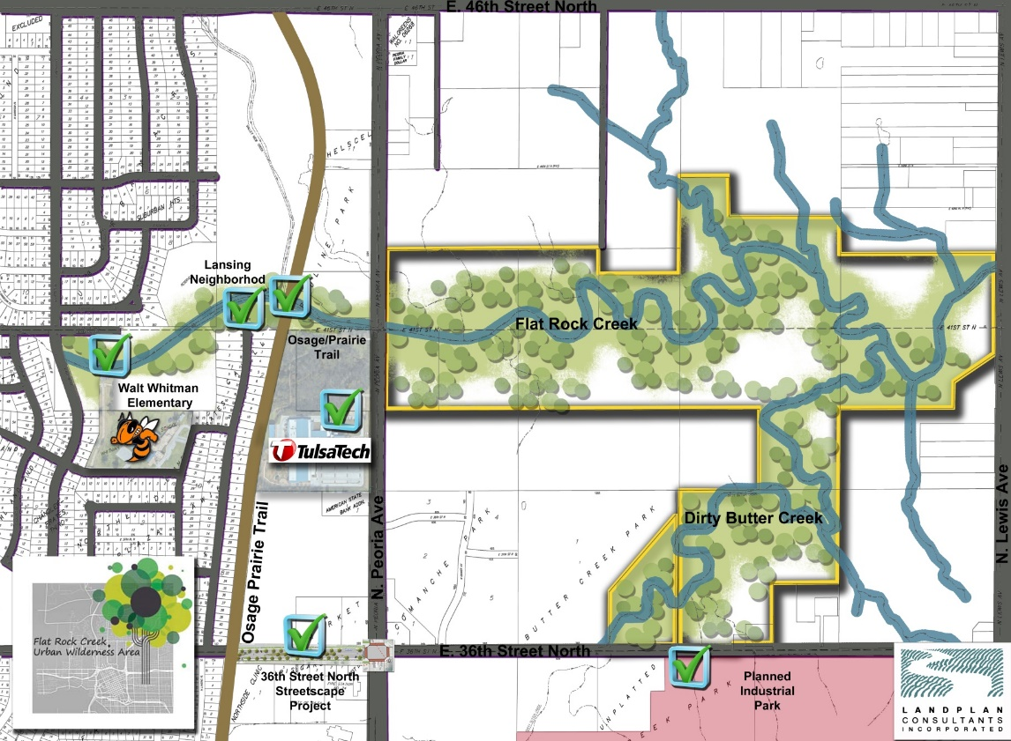
Response: Flat Rock Creek Urban Wilderness Area
Sources of Funding:
CNI $2,500,000
Peoria Mohawk TIF Fund $1,800,000
City ARPA Fund $1,000,000
State of Oklahoma ARPA Fund $1,000,000
Total $6,300,000
Partners:
City of Tulsa Parks & Recreation
Up With Trees
George Kaiser Family Foundation
Crossover Health Services
Green Country Habitat for Humanity
Oxley Nature Center
Partner Tulsa

Slide 22
Neighborhood Challenges
High crime
Notes:
**Jeff to handle this slide

Slide 23
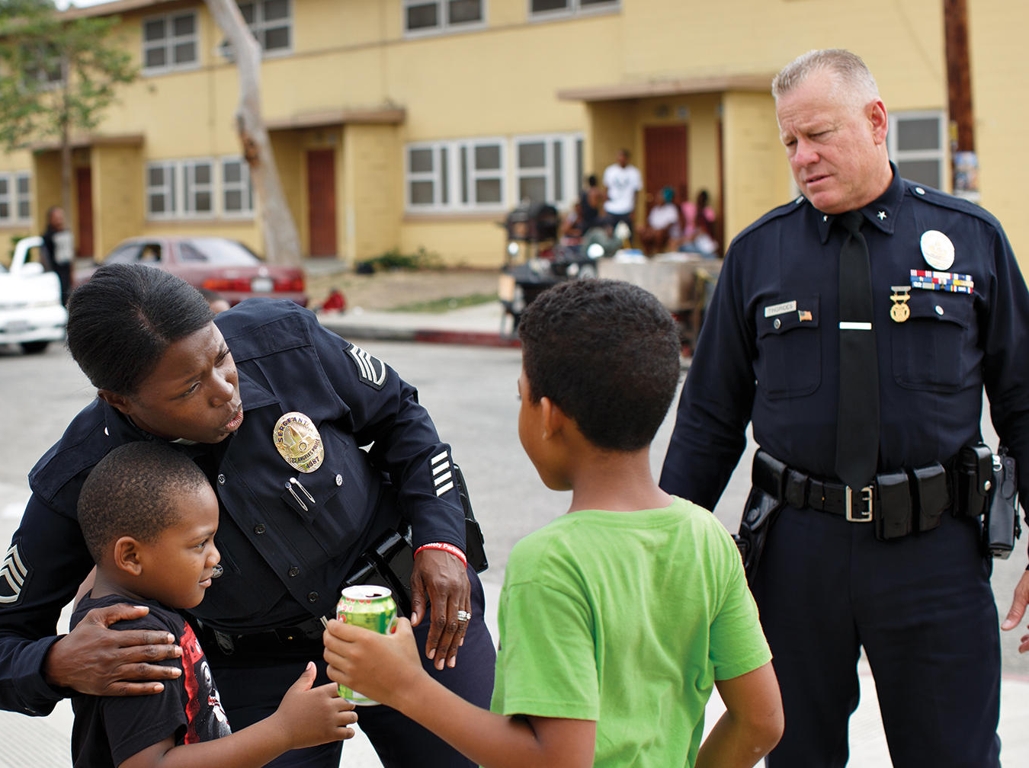
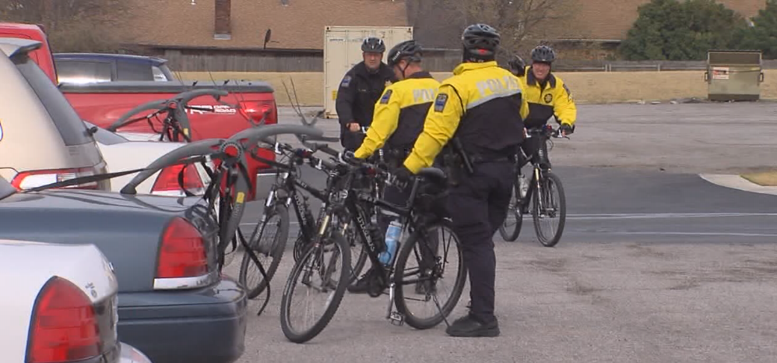
Response: Public Safety
NEED IMAGE HERE
Deploy directed patrols/ “hot spot” policing
​Develop a crime prevention awareness campaign and resident education​
Support reentry initiatives ​
Use CPTED for new developments
Partners:
City of Tulsa
Tulsa Police Department
CEO Works
Urban Strategies, Inc.
Pennrose
DITTO
Notes:
**Jeff to handle this slide

Slide 24
Questions?

