Slide 1
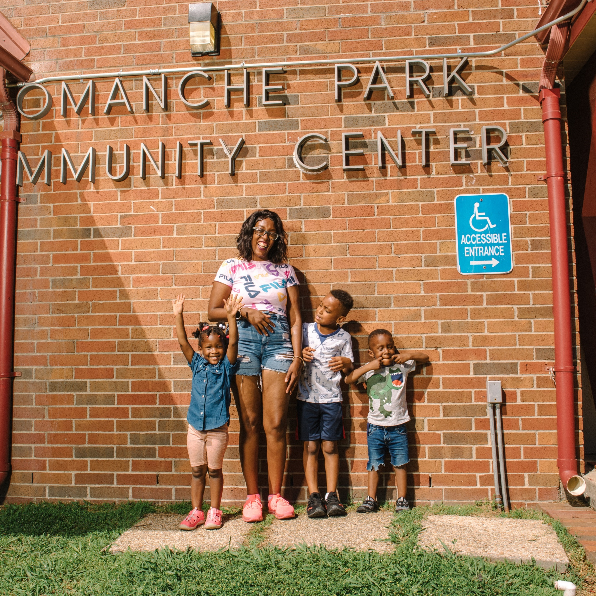
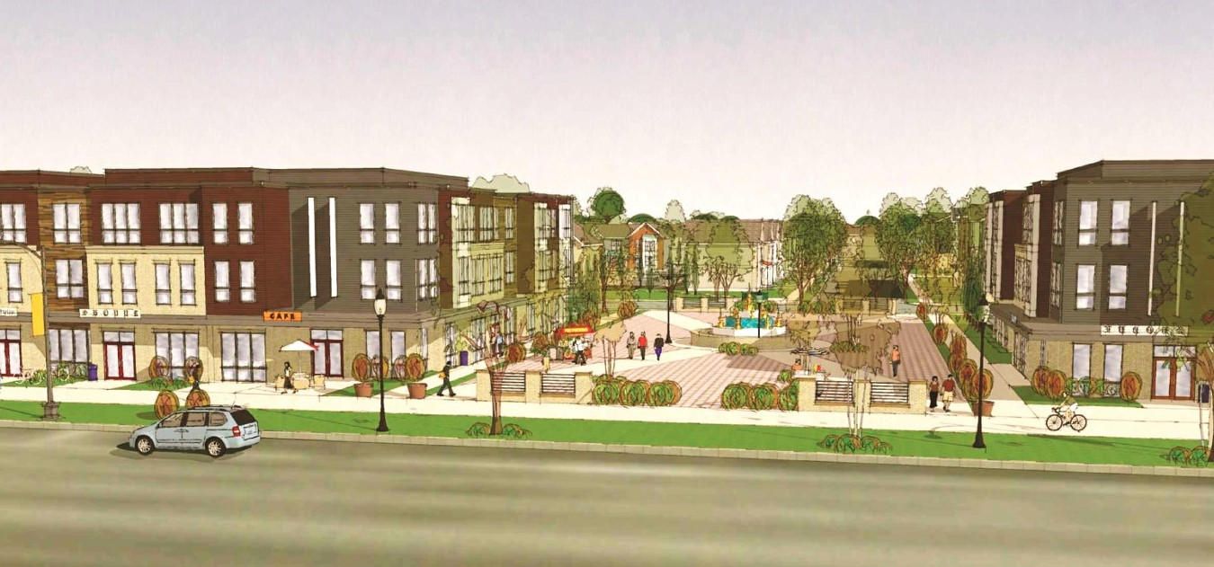


Choice Neighborhoods Implementation
HUD Virtual Site Visit
June 13, 2022

Slide 2


Welcome & Introductions
Mayor G.T. Bynum, Aaron Darden

Slide 3
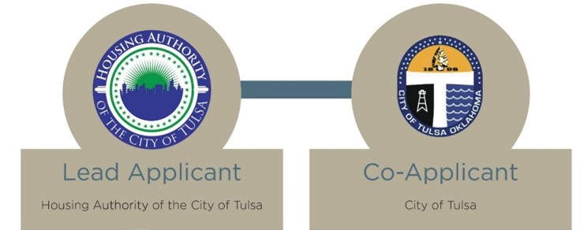




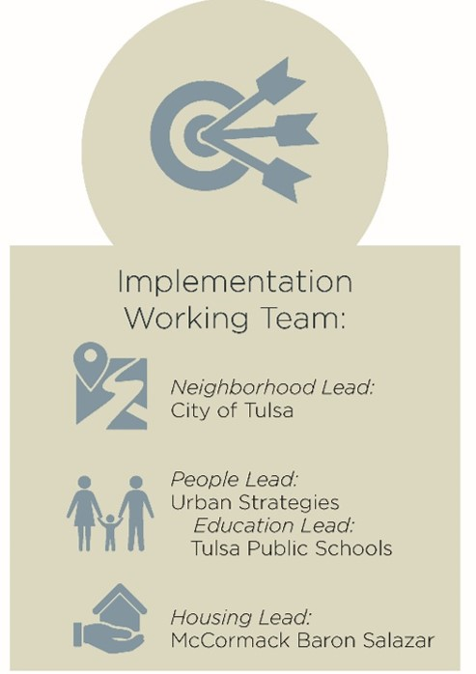
Implementation Team
Neighborhood Lead:
City of Tulsa
Housing Lead:
Pennrose
People Lead:
Urban Strategies
Education Lead:​
Tulsa Public Schools
Notes:
Aaron - Introduce Choice Neighborhoods Team – Lead Implementation Entities
City of Tulsa – Co-applicant and Neighborhood Implementation Lead, Kian Kamas, Jonathan Butler, Travis Hulse
Pennrose – Housing Implementation Lead, Tim Henkel
Urban Strategies – People Implementation Lead, Alecia Leonard
Tulsa Public Schools – Principle Education Partner, Dr. Gist will say a few words

Slide 4
Partner Organization
Alfresco Group | Be Well CDC | Capital Homes Residential Group, LLC |Crossover Community Impact | Green Country Habitat for Humanity | HBSY Properties LLC | Tulsa Planning Office | Anne and Henry Zarrow Foundation | Ascension St. John Foundation | Charles and Lynn Schusterman Family Philanthropies | City of Tulsa | George Kaiser Family Foundation | M&T Realty Capital Corporation | Oklahoma Housing and Finance Agency | RBC Capital Markets | BEST | CAP Tulsa | Community Food Bank of Eastern Oklahoma | Community Health Connection | DVIS | EduRec | Family & Children's Services of OK | Global Gardens | Green Country Workforce | Madison Strategies Group | Mental Health Association of Oklahoma | Morton Comprehensive Health Services | OK Caring Foundation | Opportunity Project | Parent Child Center of Tulsa | Reading Partners | R&G Family Foods | Sprouts Child Development| Take Control Initiative | Tulsa City-County Health Department | Tulsa City-County Library | Tulsa Community College | Tulsa Discovery Lab | Tulsa Dream Center | Tulsa Public Schools | Tulsa Public Schools Early Learning | Tulsa Tech | Goodwill Industries of Tulsa | Muncie Power Products
Notes:
About 50 Partners have committed to supporting the implementation of this project in some way

Slide 5
Team Introductions
U.S. Department of Housing & Urban Development

Slide 6


Orientation/Overview
Aaron Darden, Housing Authority of the City of Tulsa
Notes:
Introduce opening video, something like: “We’ve put together a video that gives you a sense of the landscape of our city, as well as the historical landscape that has shaped our community. We hope it provides helpful context to both our application and today’s presentations.”

Slide 7
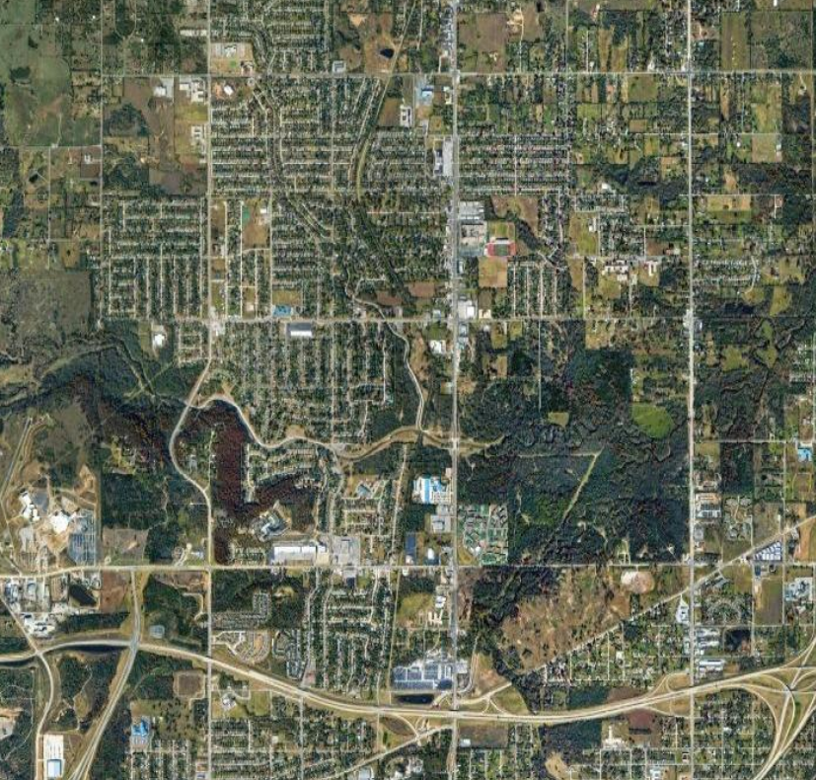
Target Neighborhood
Target Neighborhood
Comanche Park Apartments
Notes:
Now that you’ve seen the high-level view of our community, let’s dig a bit deeper. Lots of work since the implementation of the Envision Comanche Plan from 2018. The community has also been positioning itself to move on some major projects in the coming years.

Slide 8
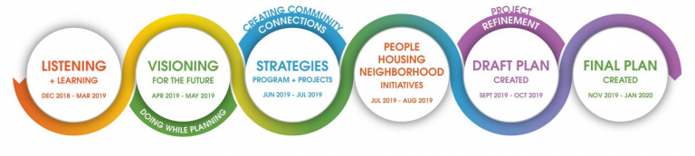
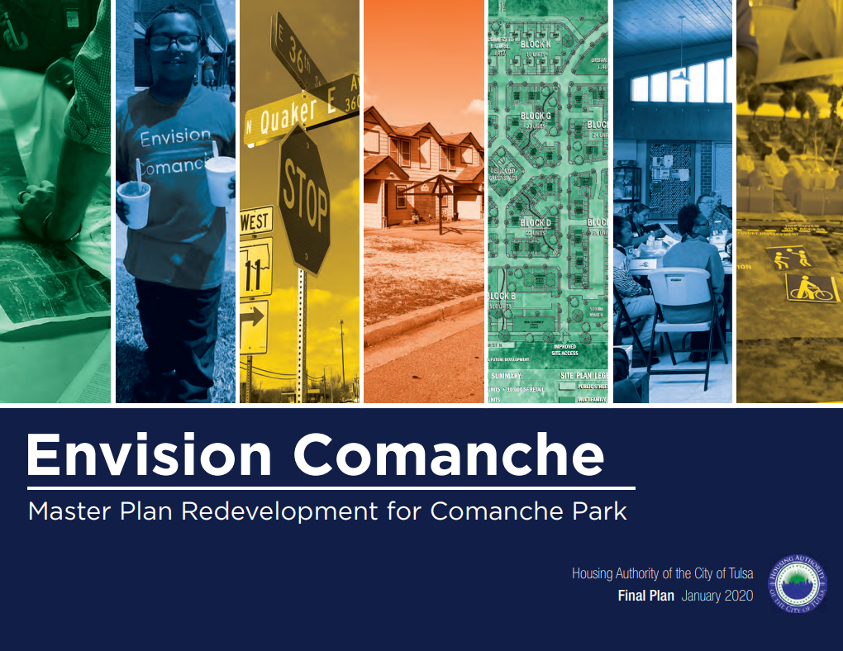
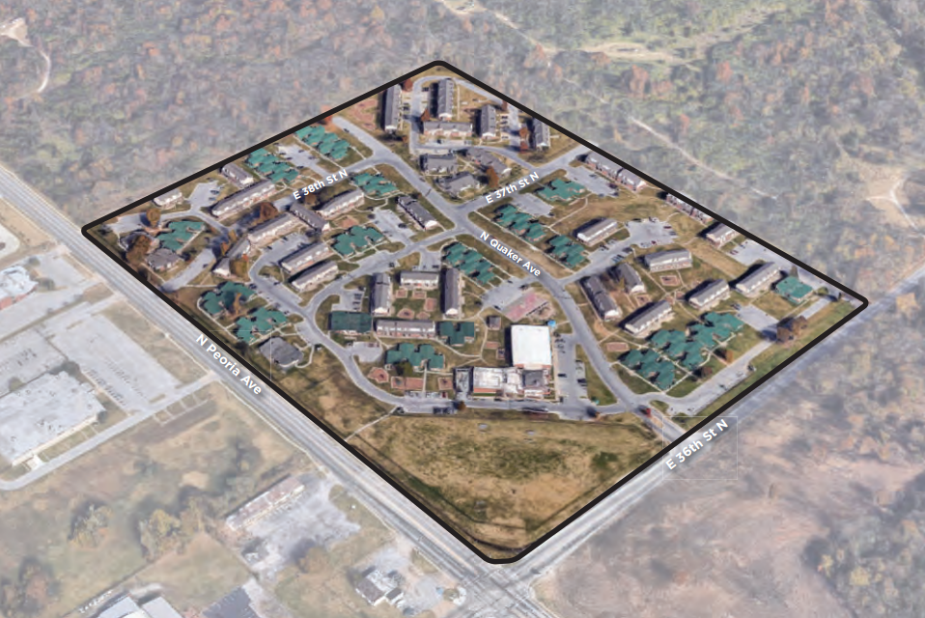
Envision Comanche Planning Process
Notes:
In 2018 THA through the support of philanthropy partners and several community and governmental organizations dedicated significate resources to the development of the Envision Comanche Mater plan. The plan encourages the creation and maintenance of an economically and socially diverse community through a mixed use mixed income community.
Envision Comanche's purpose was to engage residents and stakeholders, provide policy priorities and recommendations, focus on neighborhood efforts and provide tangible action items.

Slide 9
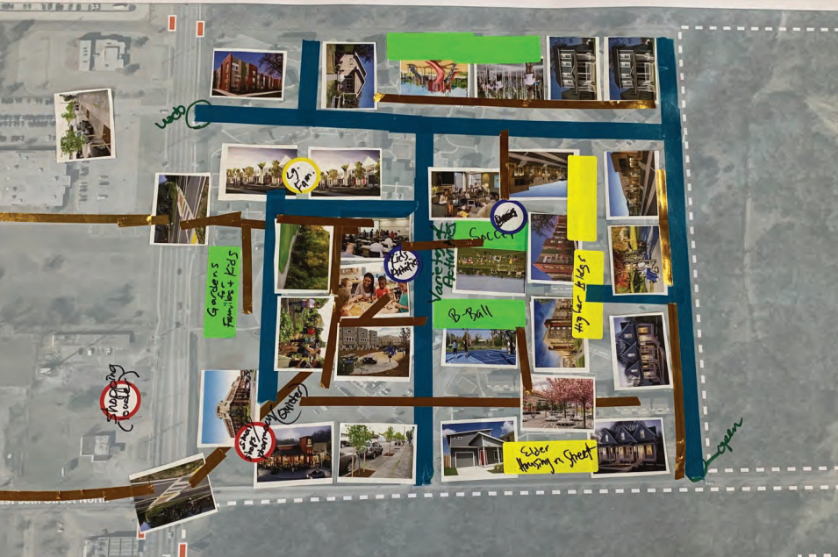
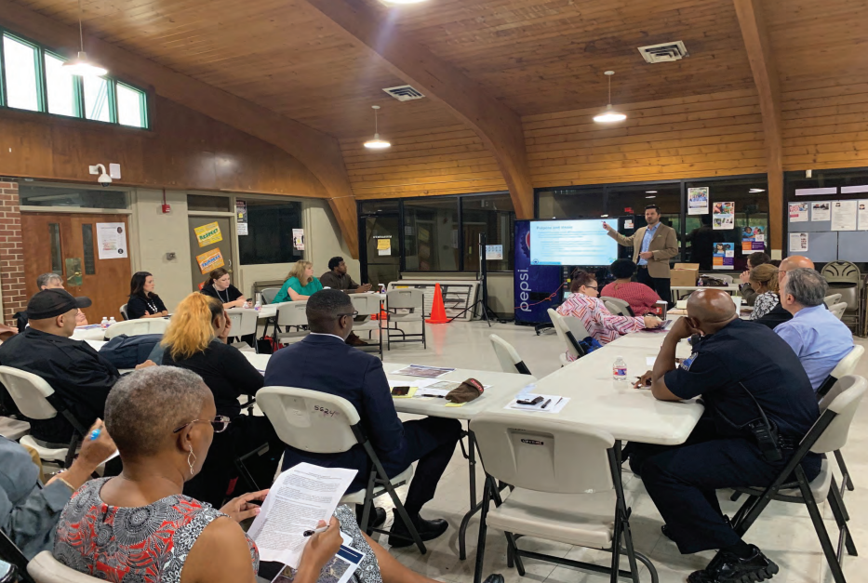
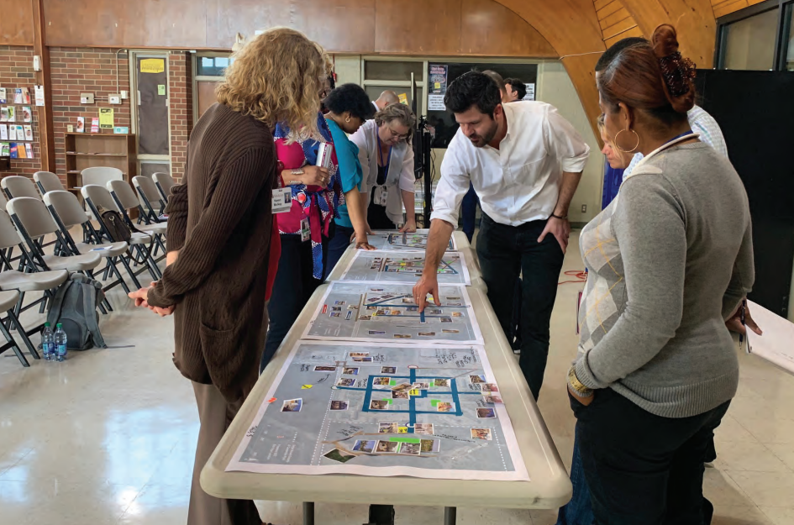
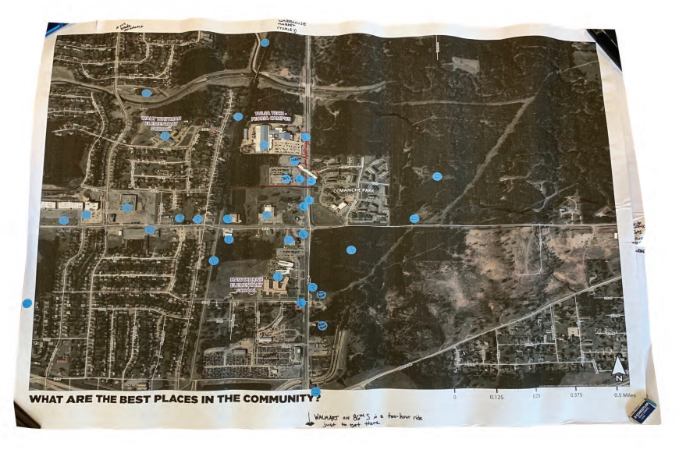
Envision Comanche Community Vision
Notes:
Residents and Stakeholders identified their vision for a successful redevelopment of Comanche Park and the surrounding Planning area.
Multiple visioning exercises and community meetings occurred to facilitate discussions.

Slide 10
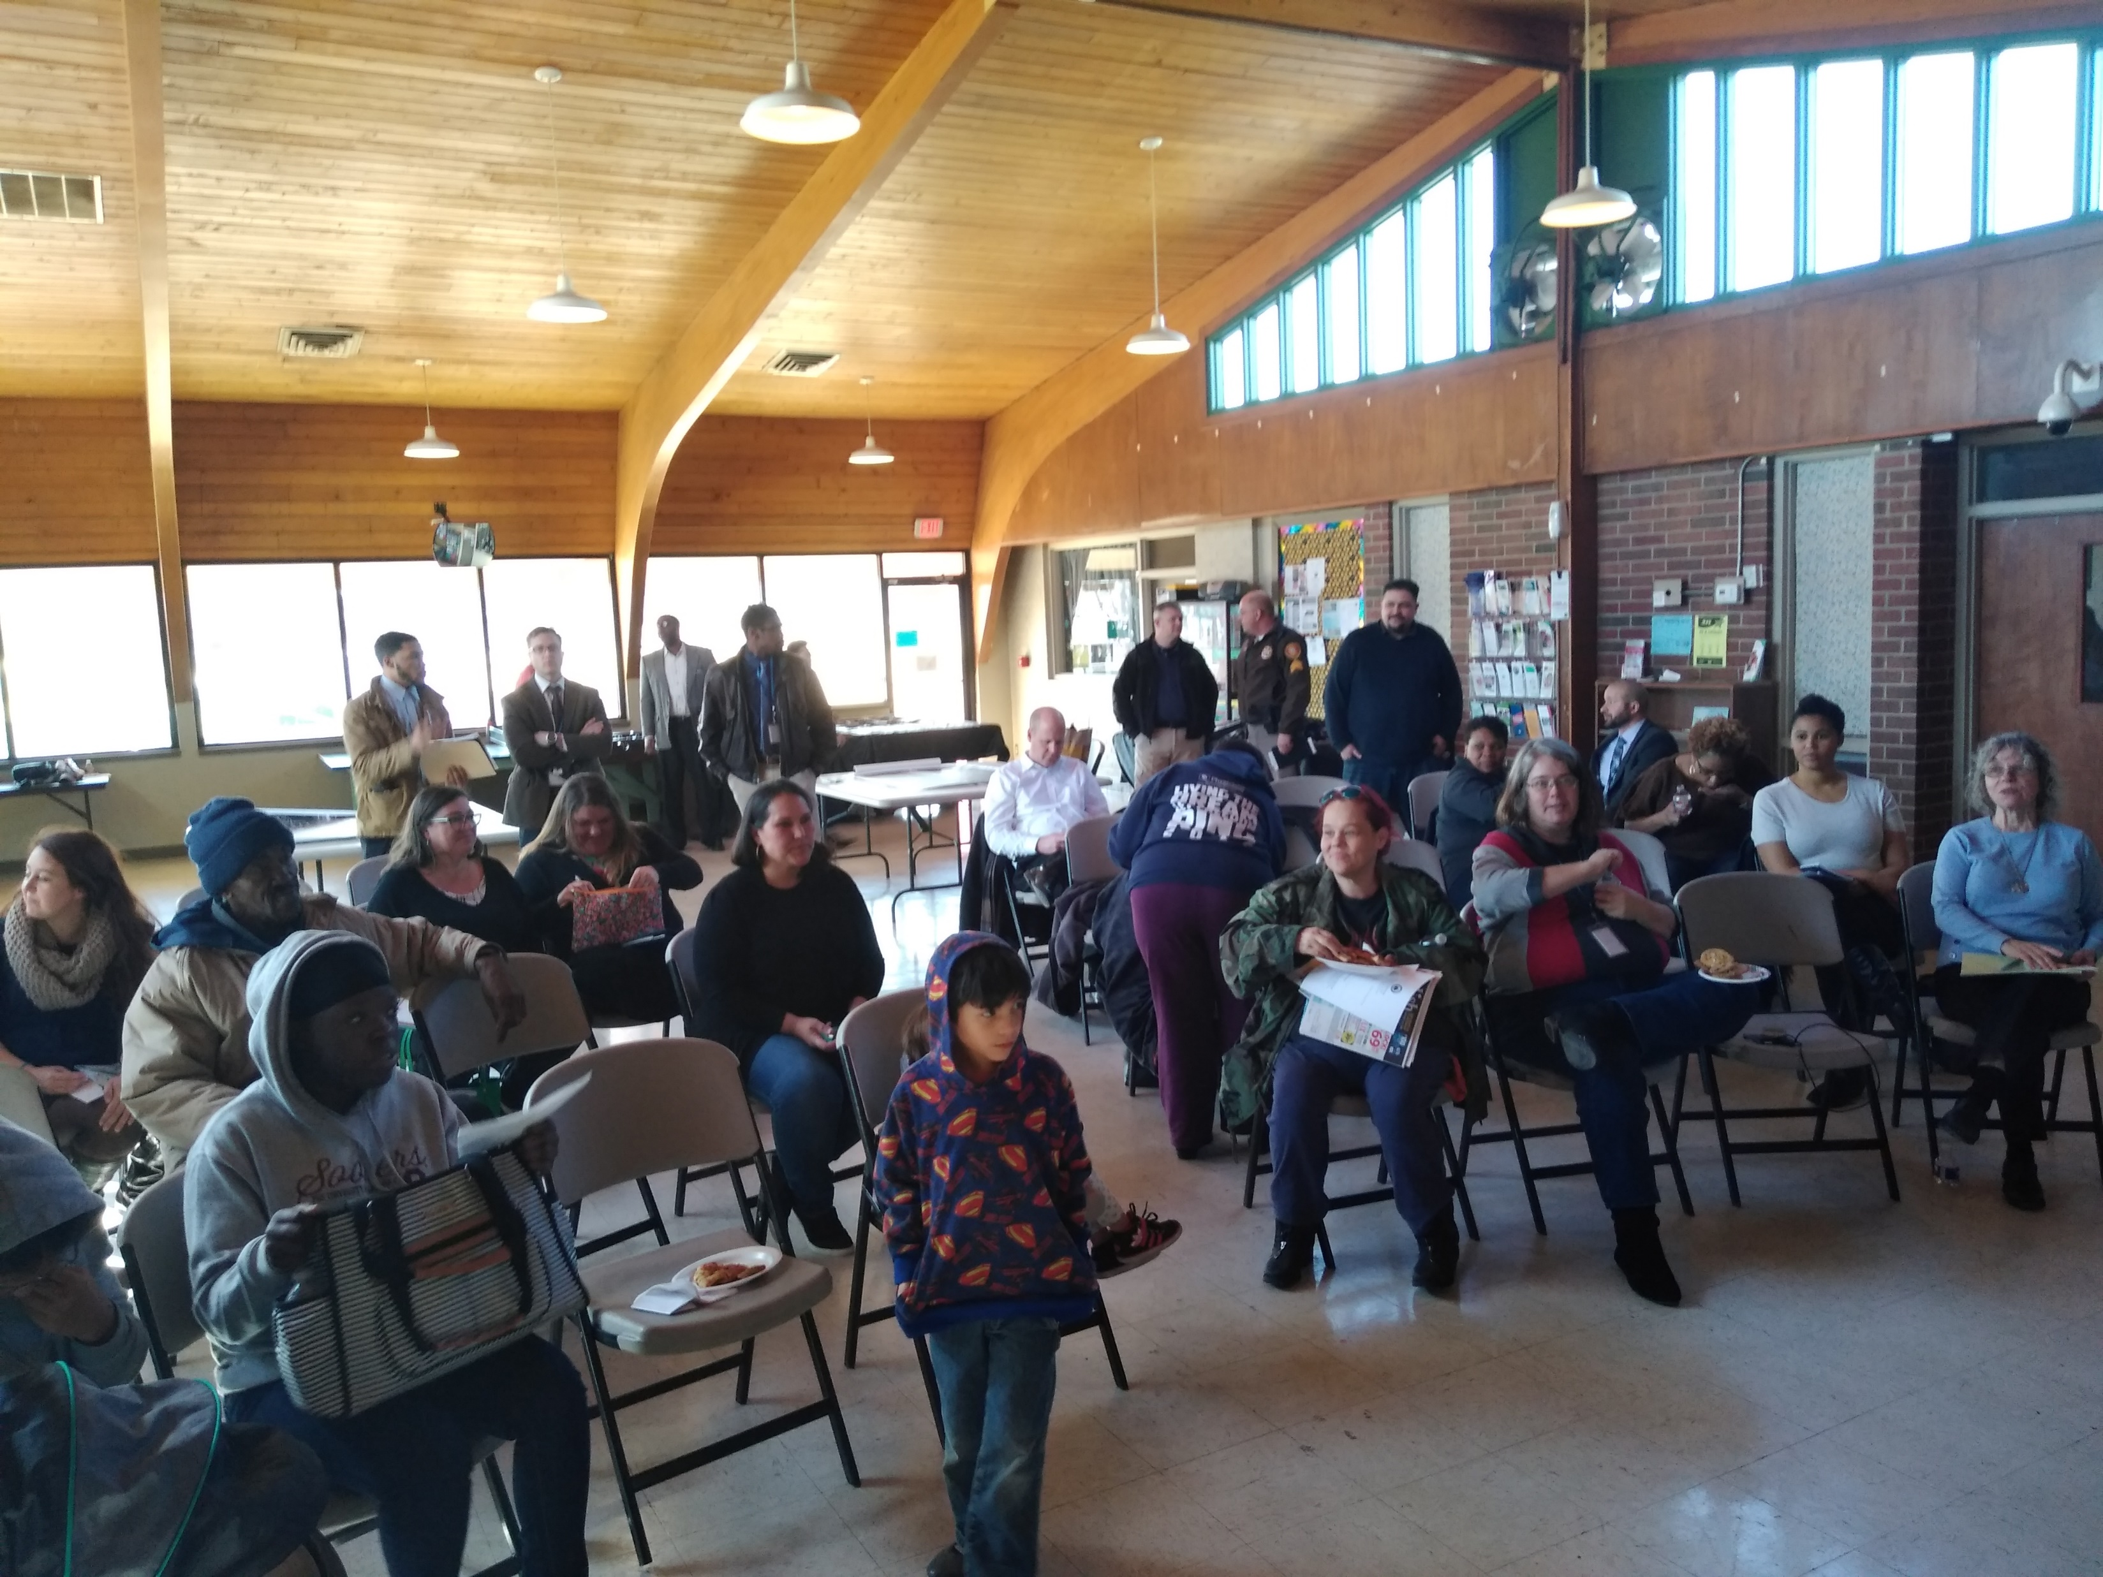
Values of 36N
Sustainable Mixed-Income Housing
Strengthened and Expanded Community Assets
Quality Education from Cradle to Career
Viable Jobs and Employment Opportunities
Quality Healthcare & Healthy Living Options
Improved Parks & Open Spaces
Improved Public Safety

Slide 11
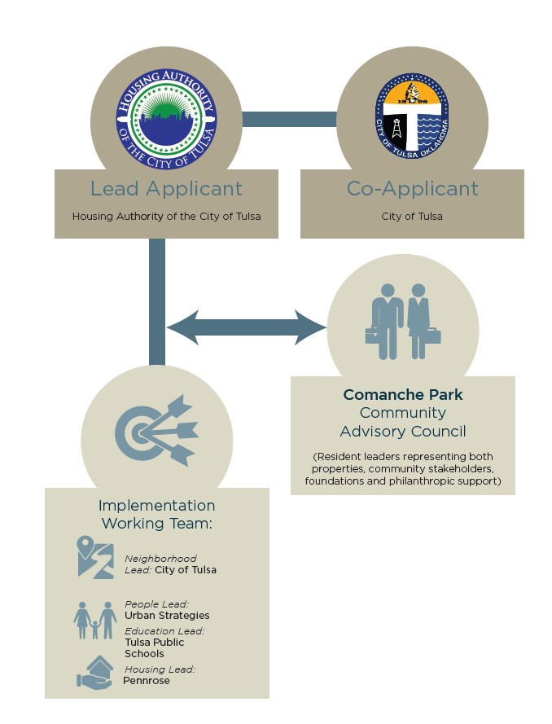
Implementation Governance
Shared implementation vision:
  Strong, varied partners that leverage existing assets and meet the needs of the community
  Community engagement that is inclusive of all residents in the target community
  Close coordination with other community initiatives
  Timely and consistent reporting
  Strong, transparent accountability structure
Notes:
At end of this slide introduce Allison Thrower, Comanche Park resident

Slide 12
Allison Thrower
Comanche Park Resident

Slide 13
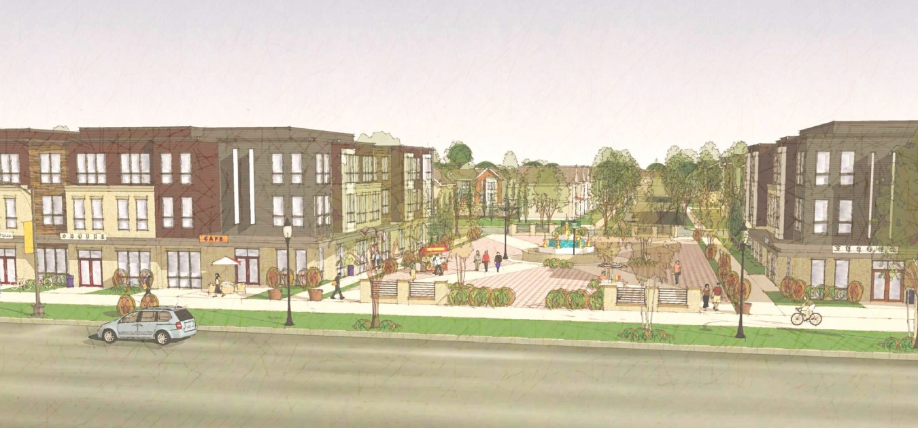
Our Commitment
Aaron Darden, Housing Authority of the City of Tulsa
Notes:
Thank Allison for her remarks.
We are committed to support the revitalization of Comanche Park and the Phoenix District.
Choice Neighborhood is key in transforming this neighborhood to one of opportunity – a place that is welcoming to everyone, that is desirable, that has jobs and housing and connections to exciting things going on.

Slide 14
Questions?

