Slide 1
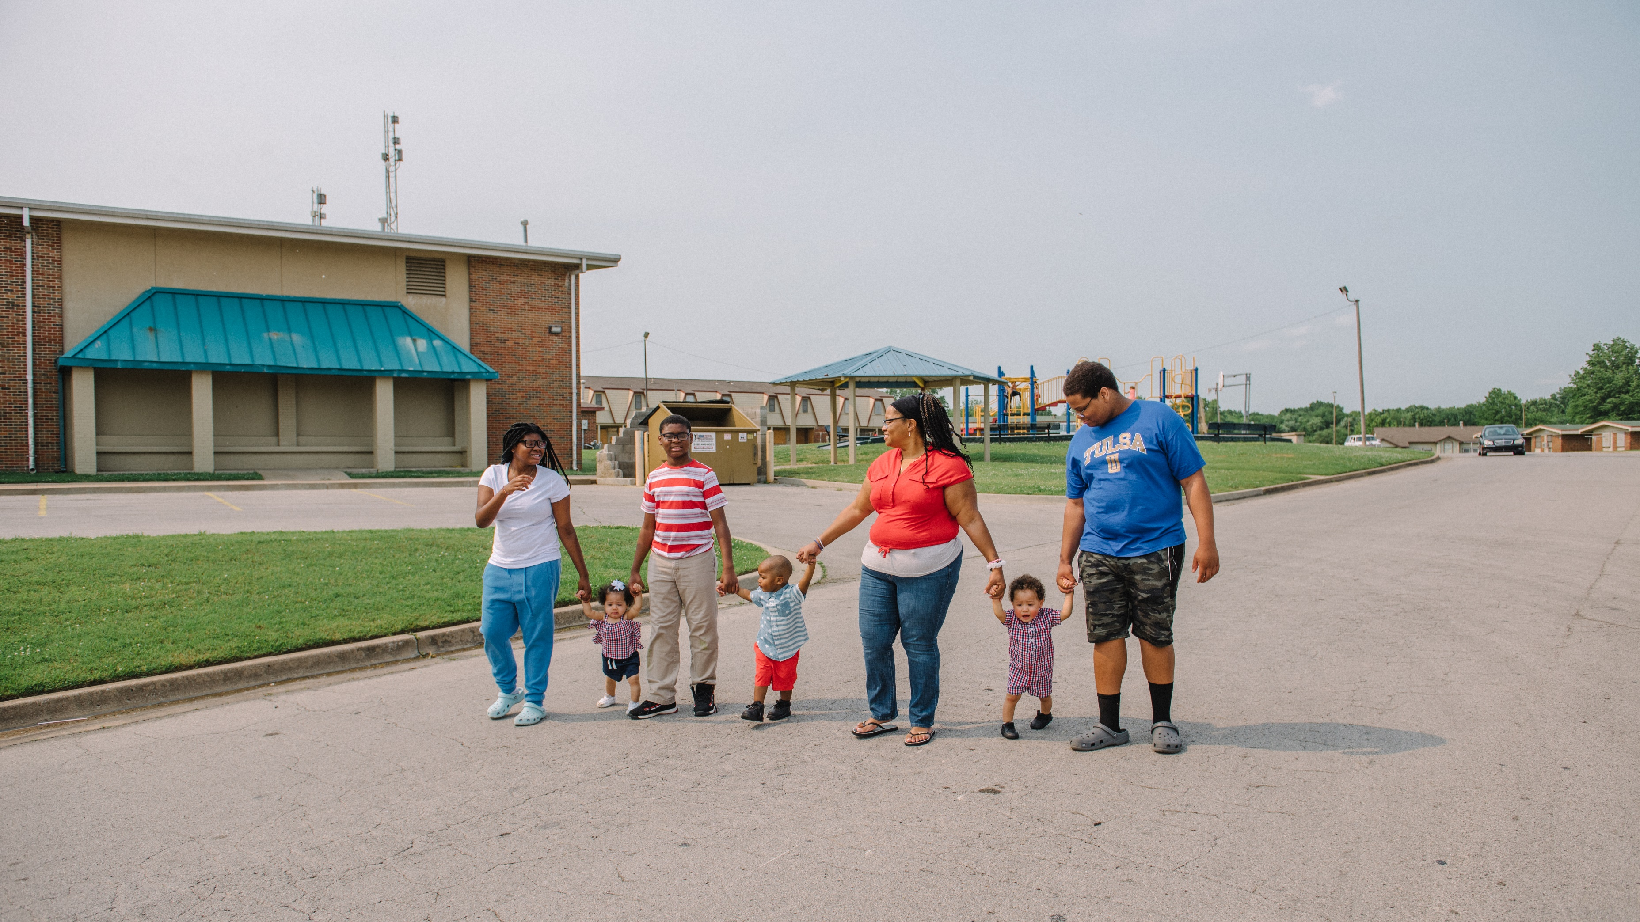

People
Urban Strategies, Inc., Lead Education Partner: Tulsa Public Schools

Slide 2





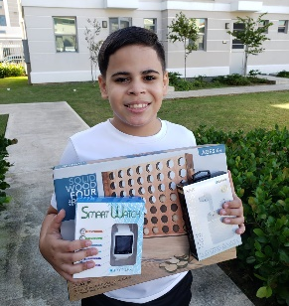
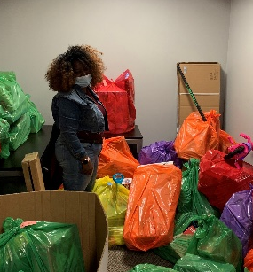
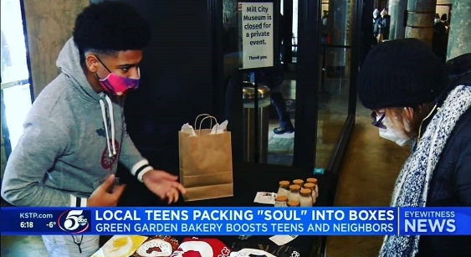
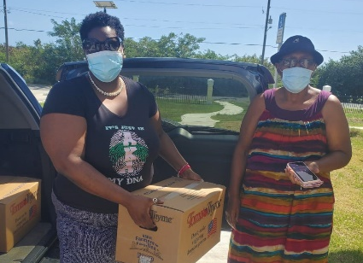
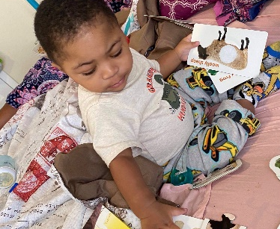
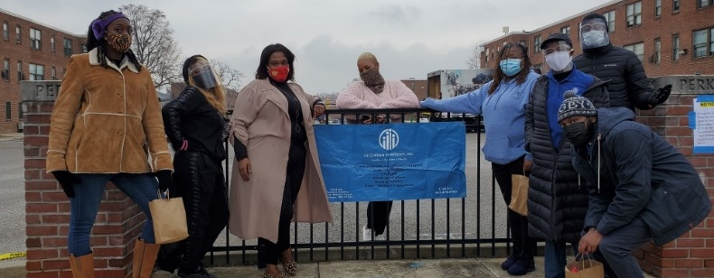
People Result
HEALTH & WELLNESS
ECONOMIC MOBILITY
EDUCATION
FAMILY SUPPORT
HOUSING STABILITY

Slide 3
Urban Strategies, Inc. Role
Engage residents throughout plan implementation
Convene network of cross-sector partners to achieve collective impact
Provide direct case management services and mobility counseling to every target household
Support continued development of resident leaders
Chart a course, informed by data, to achieve equitable, better off results for families

Slide 4
Local Staffing Plan
Regional Vice President​
​
VP of National Education Initiatives​
​
LEARN Data Analyst
Local Team:
Senior Project Manager
Assistant Project Manager
Lead Family Support Specialist
2 Family Support Specialists
Education Specialist
2 Outreach Workers
Comprehensive
case management
ratio of 45:1

Slide 5
Partner Network
Birth Through Eight Strategy for Tulsa + CAP Tulsa + Charles and Lynn Schusterman Family Foundation + Community Foodbank of Eastern OK + Community Health Connection + Crossover Community Impact + Discovery Lab + Domestic Violence Intervention Services + EduRec + Family & Children’s Services + George Kaiser Family Foundation + Global Gardens + Green Country Workforce + Goodwill Industries + Madison Strategies Group + Mental Health Association of OK + Morton Health Services + OK Caring Foundation + Parent Child Center of Tulsa + Reading Partners + RG Foods + Sprouts Child Development + The Opportunity Project + Tulsa City-County Health Department + Tulsa City-County Library + Tulsa Community College + Tulsa Dream Center + Tulsa Educare – Hawthorne + Tulsa Health Department + Tulsa Housing Authority + Tulsa Public Schools + Tulsa Tech

Slide 6
Target Resident Demographic Breakdown
133 Households, 329 Individuals

Slide 7
Target Resident Demographic Breakdown

Slide 8
Result: Households are Economically Stable &
Self-Sufficient
Baseline data provided by Tulsa Housing Authority data system

Slide 9


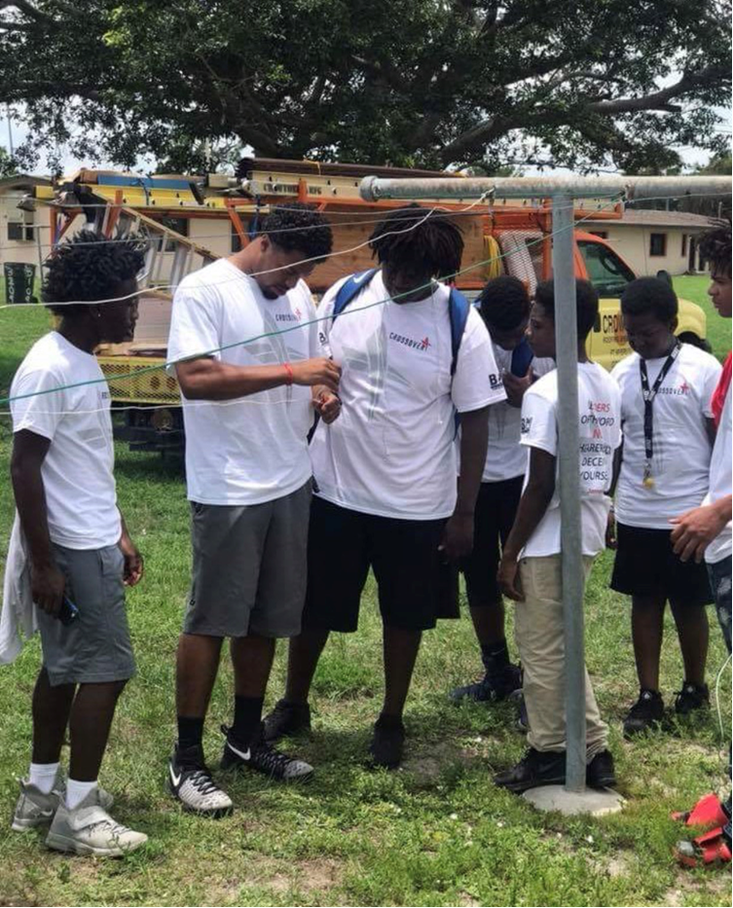
Result: Households are Economically Stable &
Self-Sufficient
Strategies:
  Connect working age adults to a coordinated pathway of economic mobility
  Raise educational attainment levels of adults
  Increase adult financial empowerment skills
Key Partners:
EduRec
Goodwill Industries
Green Country Workforce
Madison Strategies Group
Tulsa Community College
Tulsa Dream Center
Tulsa Tech

Slide 10
Children, Youth & Adults are Physically & Mentally Healthy
Baseline Data Source – Resident Needs Survey

Slide 11

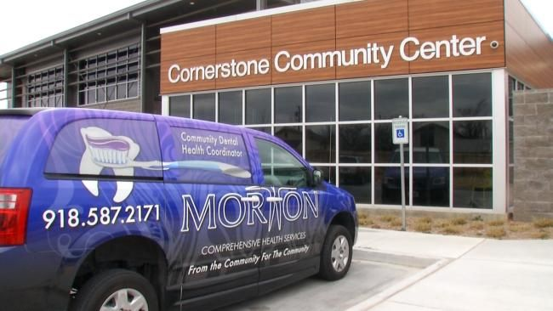
Children, Youth & Adults are Physically & Mentally Healthy
Strategies:
  Increase the number of residents regularly accessing quality physical and mental healthcare
  Improve health outcomes through prevention and wellness programming and health navigation for children through adults
Key Partners:
BEST
Food Bank of Eastern OK
Community Health Connection
Crossover Community Impact
DVIS
Family & Children’s Services
Morton Comprehensive Health Services
OK Caring Foundation
Parent Child Center of Tulsa
R&G Foods
Take Control Initiative
Tulsa Dream Center
Tulsa Health Department

Slide 12
Danielle Neves
Deputy Chief of Academics, Tulsa Public Schools

Slide 13
Result: Children Enter Kindergarten Ready to Learn
Baseline Data Source – Resident Needs Survey and Tulsa Public School data

Slide 14

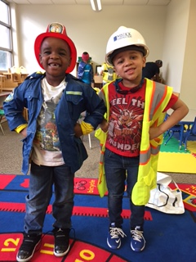
Result: Children Enter Kindergarten Ready to Learn
Strategies:
  Enroll target youth into high-quality early learning programs
  Provide Parent Support
Key Partners:
BEST
CAP Tulsa
Family and Children’s Services
Parent Child Center
Sprouts Child Development
Tulsa City-County Library
Tulsa Educare – Hawthorne
Tulsa Health Department
Tulsa Public Schools

Slide 15
Result: Children are Proficient in Core Academic Subjects
Baseline Data Source – Tulsa Public School Data

Slide 16

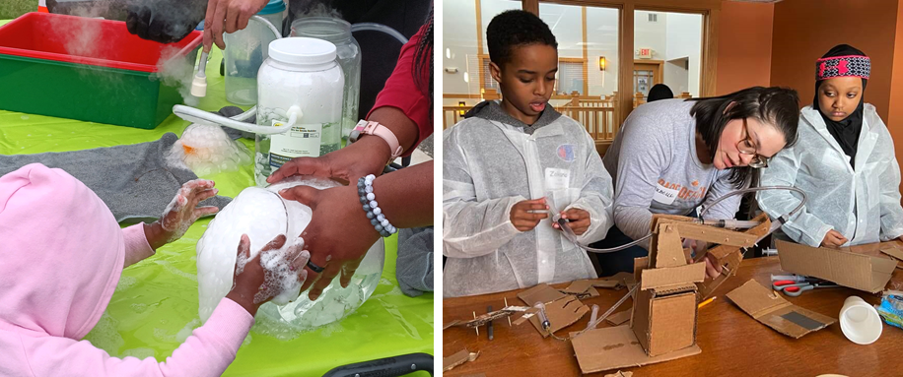
Result: Children are Proficient in Core Academic Subjects
Strategies:
  Enroll Target Youth in Expanded Learning Programs
  Reduce Chronic Absence
Key Partners:
Discovery Lab
Family and Children’s Services
Global Gardens
Opportunity Project
Reading Partners
Tulsa Dream Center
Tulsa Public Schools

Slide 17
Result: Youth graduate from high school college/career-ready
Strategies:
  Connect Target Youth to post-secondary education and career opportunities
  Connect target youth to Learn and Earn Opportunities
Key Partners:
Crossover Community Impact
Green Country Workforce
Oklahoma’s Promise
Tulsa Community College
Tulsa Public Schools
Tulsa Tech
Baseline Source – Tulsa Public Schools Data

Slide 18
People Budget Breakdown
Activity | Total Cost | Leverage
Service Coordination, Family Support & Local Operations | $3,941,400 | $4,280,000
Health and Wellness Programming | $270,000 | $19,357,847
Workforce Development Programming | $1,200,000 | $7,520,119
Education Programming | $588,600 | $46,665,630
Sustainability Endowment | $1,500,000 | $1,500,000
Total | $7,500,000 | $79,323,596

Slide 19
People Strategy Implementation Timeline
 | Task | Timeline
Engagement in Case Management | THA continues engaging residents around Transformation Plan and supporting housing stability | March 2022 to present
 | USI begins direct resident engagement into services | Within 60 days of award
 | USI Family Support team begin outreach to residents | Within 60 days of award
 | Enroll residents in Case Management and confirm school enrollment for students | Between 30 days and 6 months after award
 | Complete comprehensive needs assessment with residents and begin creating development plans | Between 60 days and 6 months of award
Service Coordination | Establish Partner Network & Action Teams | Between 30-120 days after award
 | Establish data sharing agreement with TPS | Within 180 days of award
 | Enter into MOUs with partners | Within 180 days of award

Slide 20
People Strategy Implementation Timeline
 | Task | Timeline
Priority Programming | Complete comprehensive resident needs analysis and scan of existing accessible resources | Between 4 – 8 months after award
 | Identify with partners and residents the priority programs that address specific needs where service gaps also exist | Between 8 – 10 months after award
 | Identify local funding sources to support these priorities and create fund development plan, if needed | Between 10 – 12 months after award
 | Launch initial priority programming | Year 2 of implementation period through the end
Mobility Counseling | Ensure residents understand the relocation assistance they will be provided and their housing options | Relocation start through final phase of relocation
 | Ensure residents are in good standing with their current lease and begin addressing any possible relocation or re-occupancy related barriers | Relocation start through re-occupancy
 | Create individualized relocation plans with each household to ensure any transitions with their housing – whether to housing off-site or into the newly developed – go smoothly | Upon engagement with Family Support through the end of project implementation
 | Support residents with re-occupancy into new development | At least 6 months prior to a potential unit coming online
 | Assist residents in identifying benefits and challenges with available housing options | At least 3 months prior to a potential move

Slide 21
Questions?

Slide 22
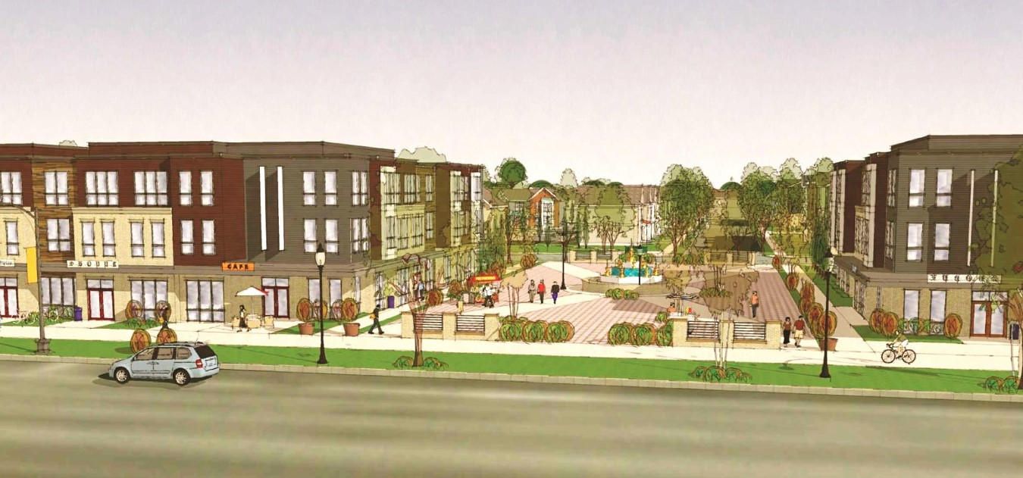
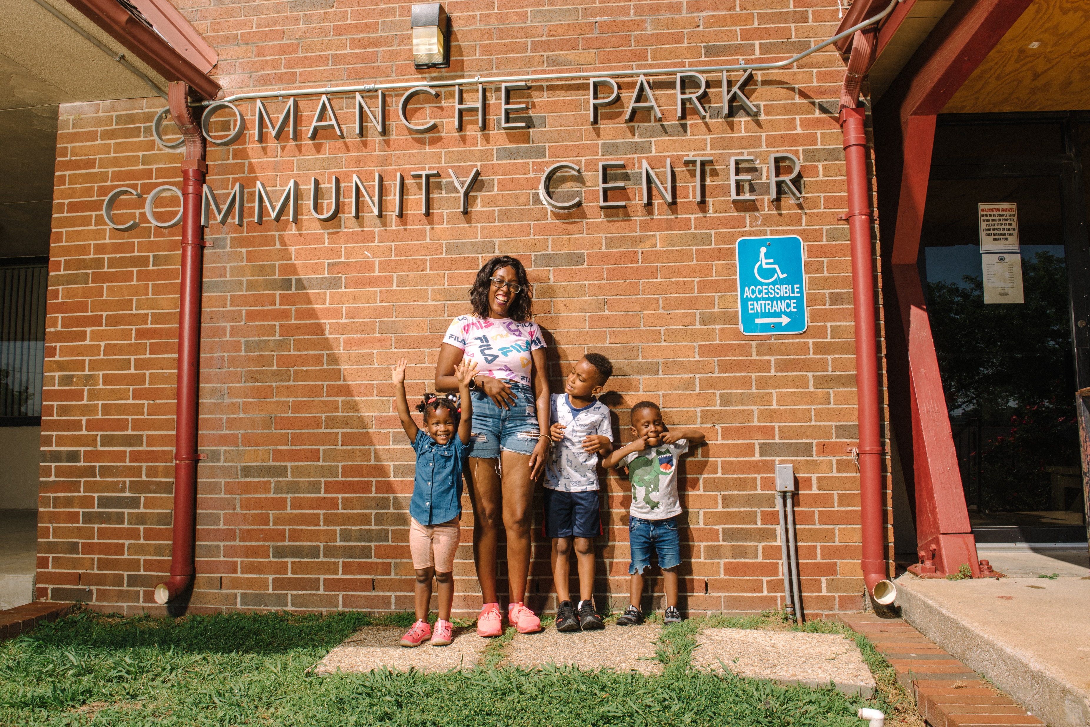

Closing
Vanessa Hall-Harper, Tulsa City Councilor
George Kaiser, George Kaiser Family Foundation

